Slide 1
Merit Badge University:
Safety
Notes:
We highly recommend you obtain and read through the merit badge safety book and this presentation before your class. It may be helpful to keep it on hand during the class as well.
**Also please note that slide 7 requires you to update it for your area
**You will need poster board and poster making supplies for requirement 6 - the actual poster making will be the last activity
**You will also need notebooks for each scout, recent newspapers pens/pencils, and a copy of the boy scout home safety checklist (3 pages per scout) found at:
http://usscouts.org/mb/docs/Home-Safety-Checklist.pdf

Slide 2
1. What is Safety?
What does it mean to be safe?
What are some different types of safety?
http://usscouts.org/mb/mb012.asp
Notes:
Allow the scouts to brainstorm and discuss briefly

Slide 3
Safety is…
Taking precautions and stopping injuries or loss before they happen
You practice safety when you actively seek to prevent accidents or ward off danger
When faced with unsafe conditions, you can practice safety by not taking unnecessary risks
Always take a moment to consider whether your actions are safe for you and for others

Slide 4
Why might you act in an unsafe way?
Being unprepared
Fatigue
Overconfidence
Fear
Haste
Excitement
Not using common sense
The lure of the forbidden
Not taking responsibility
Ignoring rules or signs
Taking chances and “just fooling around”
Notes:
Give examples - the book provides some

Slide 5
Prepare your Notebook
Make sure to include your name and troop number
Explore the newspapers provided and cut/paste into your notebook stories about:
Injuries at home and work
Crimes

Slide 6
National Accident Facts and Stats 2015
Cause of Death | Odds of Dying
Accidental Poisoning | 1:109
Motor Vehicle Crash | 1:112
Falls | 1:144
Accidental drowning | 1:1,113
Exposure to Fire, Flames or Smoke | 1:1,442
Choking from Inhalation and Ingestion of Food | 1:3,375
Air and Space Transport Incidents | 1:8,015
Contact with Sharp Objects | 1:37,351
Contact with Heat and Hot Substances | 1:59,093
Lightning Strike | 1:164,968
There are 4 major categories of accidents: motor vehicle, work, home, and public
Don’t become a statistic!
Seek knowledge and skill
Be prepared
Know and accept your limitations
http://www.nsc.org/learn/safety-knowledge/Pages/injury-facts-odds-of-dying.aspx

Slide 7
STATS in fort worth 2013
ACCIDENTS
CRIMES
62 fatal car crashes involving 92 vehicles
16 fatal crashes involving drunk people - even if you are being safe, others may not be!
The total number of fatal crashes has remained mostly steady over the past few years
5.59 violent crimes per 1,000 residents
43.72 property crimes per 1,000 residents
Higher than both the national average and the state average
However, crime has fallen 5.8% in the first half of 2015
http://www.city-data.com/accidents/acc-Fort-Worth-Texas.html
http://www.neighborhoodscout.com/tx/fort-worth/crime/
https://www.fortworthpd.com/docmgmt/2015-1st-Quarter-Crime-Report_Final.pdf
Notes:
**Make sure you edit this slide with statistics from your local area
Also be sure the scouts are recording this in their notebooks

Slide 8
http://www.city-data.com/accidents/acc-Fort-Worth-Texas.html
Why do you think motor vehicle accidents follow this weekly trend?
Notes:
Discuss and explain the importance of being safe even (or especially) on the weekends when they may be out having fun and being adventurous - this lesson extends past using motor vehicles

Slide 9
Notebook activity
Write a paragraph or more explaining how a serious fire, accident, or crime could change your family life

Slide 10
Notebook activity
Make a list of safe practices and safety devices that your family currently uses
Notes:
If time allows, let them share some of their ideas

Slide 11
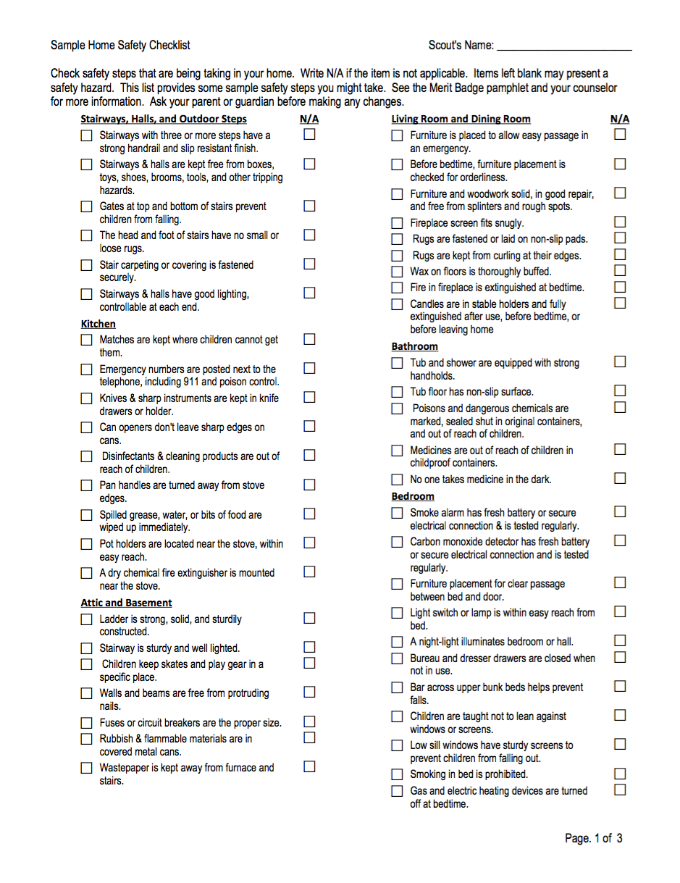
2. How safety conscious is your family?
Use the provided safety checklist to determine how safe your home is currently
Explain any hazards and how you can correct them
Notes:
distribute print outs of the boy scout home safety checklist (3 pages) found at:
http://usscouts.org/mb/docs/Home-Safety-Checklist.pdf

Slide 12
In Case of Emergency (ICE)
If you have a cellphone, add a contact named ICE so that emergency workers can find someone to notify quickly
As a minor, you should choose a parent or guardian that can give consent for your emergency medical treatment
http://blog.digifit.com/2011/08/ice-in-case-of-emergency/

Slide 13
Fire Safety
What are some common causes of house fires?
What are some tools that contribute to fire safety?
http://www.oafc.on.ca/sites/default/files/uploads/PublicSafety/Escape-Plan-web.jpg
Notes:
Allow them to brainstorm and discuss

Slide 14
House fires are caused by…
Cooking - stay in the kitchen while cooking and NEVER pour water on a grease fire, cover it with a lid instead to smother it
Heating - keep things that could catch fire at least 3 ft from a furnace, space heater, or fireplace
Electrical appliances - follow all manufacturer instructions, unplug devices when not in use, and NEVER reach into water to retrieve a plugged in appliance
Smoking - never allow someone to smoke while sleepy, in bed, or while drinking and be sure ashtrays are cold when emptied

Slide 15
Fire Safety Preparedness
Remember, flames are not the only danger in a fire - poisonous gases and smoke can deprive a person of oxygen
Make sure your family has a fire escape plan and hold practice drills from time to time
Make sure your route works - for example, some windows may be painted shut or blocked
The best thing is prevention!

Slide 16
Notebook activity
Create a plan of escape in case of fire in your home
Share your fire escape plan and the common causes of fires with your family members once you return home

Slide 17
3. Community Safety
Accidents, such as a house fire or wind damage, can be centered on your home but don’t involve the whole community
Disasters can disrupt your entire community, such as earthquakes or floods
http://www.hudson.oh.us/index.aspx?NID=675

Slide 18
Major Disaster Preparedness
Plan to store enough supplies for everyone in your household (including pets) for at least 3 days
Assume you may not have food, water, electricity, or a phone
Periodically inspect perishable items like batteries and medications to ensure they are usable
When calling 911 from a mobile phone, remember the dispatcher cannot automatically determine your location

Slide 19
Road Safety
As a pedestrian, cross streets only where marked, and look both ways before stepping off the curb
As a bicyclist, wear a helmet and keep your bike properly maintained
If using a motorcycle, ATV, scooter, etc. remember there may be certain restrictions such as age and licensing
As a passenger, wear your safety belt properly, lock doors, and help the driver remain undistracted and attentive

Slide 20
Online Safety
Get your parent’s permission and follow your family’s rules for going online
Protect your privacy by never exchanging pictures or personal information (phone number, address, last name)
Do not open emails or files from people you don’t know or trust
Never agree to meet someone you met online without your parents
Never share online passwords with anyone other than parents
Keep in mind, everything online can be seen by anyone

Slide 21
Identity Theft
Identity theft is when a criminal steals someone’s personal information to impersonate this person and make legal transactions
Be careful not to share personal information about you or your family including birth dates, address, phone numbers, and Social Security Numbers
Do not purchase anything online without permission
Remove the daily mail promptly
Shred documents containing personal information before throwing them away

Slide 22
Recognizing Child Abuse
Child abuse can be:
Physical - intentional injury often stemming from extreme punishment
Emotional - needless injury to a child’s self esteem
Neglect - deliberate failure to provide a child his/her basic needs
Sexual - an adult or older child, called a molester, forces or manipulates a child to be involved in a sexual activity

Slide 23
Three R’s of Youth Protection
Recognize situations that place you at risk of being molested, how child molesters operate, and that anyone could be a molester
Resist unwanted or inappropriate attention
Report attempted or actual molestation to a parent or other trusted adult
Talk with your parents and siblings about the dangers of talking with or accepting rides from strangers, and trust your instincts

Slide 24
Safety in Public Places
Panic can be dangerous, especially in large crowds - set an example by staying calm in the face of trouble
Be prepared by getting into the habit of finding multiple exits in public places - remember, the door you entered through is the most dangerous in an emergency because it will be the most crowded
Never use an elevator during a fire

Slide 25
Camping Safety
Do no pitch tents near an open fire
Do not use flammable chemicals near tents
Only allow flashlights and electric lanterns in tents
Always extinguish cooking and campfires properly
Obey all fire laws, ordinances, and regulations

Slide 26
Swimming Safety
All swimming activities should be supervised by mature adults age 21 or older, preferably with at least one BSA Lifeguard
Require evidence of fitness for swimming
Swim in a safe area without strong currents and preferably with clear water
Swim only when there are lifeguards on duty and have a lookout
Divide participants into 3 groups: non swimmer, beginner, swimmer
Use the buddy system and follow all directions/rules

Slide 27
Lightning Safety
Avoid open areas and lightning targets such as trees or flagpoles
Avoid water and anything metal, do not use landlines or anything connected to an electric outlet
If you are hiking near mountains, get downhill and take shelter in a cave or a low spot among rocks and in an area not likely to flood
Take shelter in a building or a hard topped motor vehicle if possible
If you can’t find shelter, get small and cover your ears - the less of you that is touching the ground, the better

Slide 28
4. Know Your Exits
Many public areas will have evacuation plans online
Get into the habit of finding the exits when you enter a public area
Teach your family what to do in case you need to take shelter in or evacuate a public area
https://www.unthsc.edu/operations/emergency-management/emergency-evacuation-procedures-25/

Slide 29
Discussion Activity
What is the best route to exit the building that you’re currently in?
Notes:
If time allows, take the scouts out around the building and allow them to discuss routes to exit different areas

Slide 30
Taking Shelter
How you should take shelter varies by disaster types
If you can, listen to the radio to keep up with the local emergency broadcasts and follow their directions
http://whyfiles.org/2014/tornadoes-strike-again-how-do-they-work/

Slide 31
5. Accident Prevention Plan
Make an accident prevention plan for 5 family activities outside the home (for example at the movie theater or while traveling)
Include an analysis of possible hazards, a proposed plan of action to correct hazards, and reasons for your proposed corrections
http://www.lni.wa.gov/safety/topics/atoz/APP/
Notes:
(in the notebooks)

Slide 32
6. Safety Project
At the end of the class, we’ll be making posters for you to put up in your schools/communities
Think about which safety topic you may want to focus on
Keep this in the back of your mind as we continue so you have some ideas for posters later
http://www.scouting.org/Home/BoyScouts/AdvancementandAwards/MeritBadges/mb-SAFE.aspx

Slide 33
7. The National Terrorism Advisory System
The U.S. Department of Homeland Security communicates information about terrorist threats, manages U.S. borders and immigration, and coordinates responses to emergencies
The National Terrorism Advisory System (NTAS) will issue an NTAS alert when there is a terrorist threat - there are two types of alerts
Elevated Alert warns of a credible terrorist threat
Imminent Alert warns of a credible, specific, and impending terrorist threat

Slide 34
Homeland Security Website
Each alert includes geographic region, mode of transportation, or critical infrastructure that could be potentially affected
Citizens should report suspicious activity to their local law enforcement authorities
You can see a sample alert on the Homeland Security website at http://www.dhs.gov/sites/default/files/publications/ntas-sample-alert_0_0.pdf
This website will also display any current alerts
http://www.dhs.gov/ntas-public-guide

Slide 35
8. Safety Careers - Fire and Safety
Firefighters rescue people, raise ladders, hook water hoses up, and enter burning buildings
Fire inspectors help prevent fires by ensuring fire ordinance, laws, and codes are being followed
Fire investigators use clues left after the fire to determine the starting point and cause
Fire safety technicians plan fire protection systems like ceiling sprinkler systems in public buildings

Slide 36
Fire and Safety
To be a fire fighter you ned a high school diploma and advanced first aid training - in many areas advanced first aid training is needed
Fire investigators, inspectors, and safety technicians need 2-4 years of college in a fire program
A position may require state fire certification, paramedic certification, or other special qualification
An applicant for a fire inspector, investigator, or technician, often needs two or more years of experience as a firefighter

Slide 37
Safety Engineer
Safety engineers reduce or minimize the number of preventable accidents in in the workplace by anticipating hazardous conditions
Certification as a safety engineer and several years of experience as either a safety technician or assistant safety engineer are needed
A four year degree in industrial engineering is preferred
Work can often be found in a warehouse or a manufacturing, chemical, or oil and gas plant

Slide 38
Law Enforcement
Police officers enforce the law, preserve the peace, control crowds, and arrest and stop criminals
Detectives obtain information about criminals and their activities through surveillance, interviews, and research
High school education is required, but a 2 or 4 year college degree is preferred
Candidates must pass a written test, prove physical fitness, and are checked for character and a past arrest record
After being hired, an officer must pass special training and work with an experienced officer for several months - after three years he/she is usually allowed to apply for a detective position

Slide 39
Other Safety Careers
Risk management - many companies and organizations have risk managers who assess the safety of planned activities
Code enforcement - code enforcement personnel asses the implications of safety codes on the trades an the consumers
Fire marshal - persons trained in how fires start and the damages that can occur
Occupational safety analysis - experts in industrial functions and products anticipate how on-the-job accidents can occur and how they can be prevented
Safety advocates - consultants who advocate safety in the environment, transportation, community, and institutions

Slide 40
Discussion Activity
Get into mini groups and pick one career in the safety field - discuss your choices with your group
Explain why this profession may interest you
Notes:
group size will depend on number of students in class, ideally have 4-5 scouts in each group or allow them to form groups by troop

Slide 41
Safety Project
Stay in your mini groups and pick a safety topic that you think your community should be more aware of
Make posters and plan ways to get your message out
http://www.scouting.org/Home/BoyScouts/AdvancementandAwards/MeritBadges/mb-SAFE.aspx

