Slide 1
PUBLIC HEALTH
UNTHSC Merit Badge University 2016

Slide 2
Topics for Public Health Merit Badge
Definition of Public Health
Immunizations
Drinking water
Disease vectors

Slide 3
Topics for Public Health Merit Badge (continued)
Food safety activity on campus
Pollution
Drugs
Meet with UNTHSC Public Health Department
Careers in public health

Slide 4
Definition of Public Health
Public health is the act of “maintaining and
monitoring the health of communities, and with the
detection, cure, and prevention of health risks
and diseases.”

Slide 5
Definition of Public Health
Helps prevent disease and injury
Teaches people how to be healthy
Provide basic healthcare services to certain communities
Protect people from environmental hazards

Slide 6
Definition of Public Health
Common Examples
Common examples of diseases that the field of public health is concerned with:
Escherichia coli (E. coli bacteria) – Bacteria from normal gut fauna that is ingested through fecal contamination of food. Gastrointestinal symptoms usually clear up on their own.

Slide 7
Definition of Public Health
Common Examples
Tetanus (Clostridium tetani bacterial toxin) – Bacteria enters bloodstream through break in skin and creates harmful toxins that circulate in the body. Treated with antitoxins, but immunization perferrable.

Slide 8
Definition of Public Health
Common Examples
AIDS (Human Immunodeficiency Virus) – Virus is transmitted through bodily fluids by either intimate contact or blood transfusions. Treated with antiviral therapy, but no cure.

Slide 9
Definition of Public Health
Common Examples
Encephalitis (multiple viral and bacterial causes) – Infection with either bacteria or virus that causes brain swelling. Frequently from arbovirus in mosquitoes. No single cause so no defined vaccine or treatment.

Slide 10
Definition of Public Health
Common Examples
Salmonellosis (many different gut bacteria) – Infection with either bacteria or virus that causes brain swelling. Treated with antibiotics.

Slide 11
Definition of Public Health
Common Examples
Lyme disease (spirochete bacteria) –Usually transmitted through tick bites. Causes characteristic “bull’s-eye rash.” Can be treated with antibiotics.

Slide 12
Definition of Public Health
Common Examples
West Nile (West Nile Virus) –Virus carried by mosquitoes. Severe flu-like symptoms. No vaccine or treatment. Can cause potentially fatal encephalitis.

Slide 13
Definition of Public Health
Common Examples
Influenza (flu viruses) –Virus spread by person to person. Endemic in the population (never disappears). Only potentially fatal for extremely young or old. Vaccines cover most likely flu viruses for the year, but not all can be included.

Slide 14
Definition of Public Health
Common Examples
Lead poisoning (ingestion or inhalation of environmental lead) –Lead is extremely toxic and can cause brain, nerve, and blood damage. No treatment, but recommended amounts of calcium and iron in diet can lessen absorption. Not as much of a problem these days.

Slide 15
Definition of Public Health
Common Examples
Meningitis (both viral and bacterial types) – Causes swelling of meningeal tissue surrounding brain and spinal cord. Can be severe and cause permanent brain damage or death. Bacterial type is more dangerous, and vaccinations are critical.

Slide 16
What do all these common diseases have in common?

Slide 17
Steps can be taken to prevent them!

Slide 18
Steps can be taken to prevent them!

Slide 19
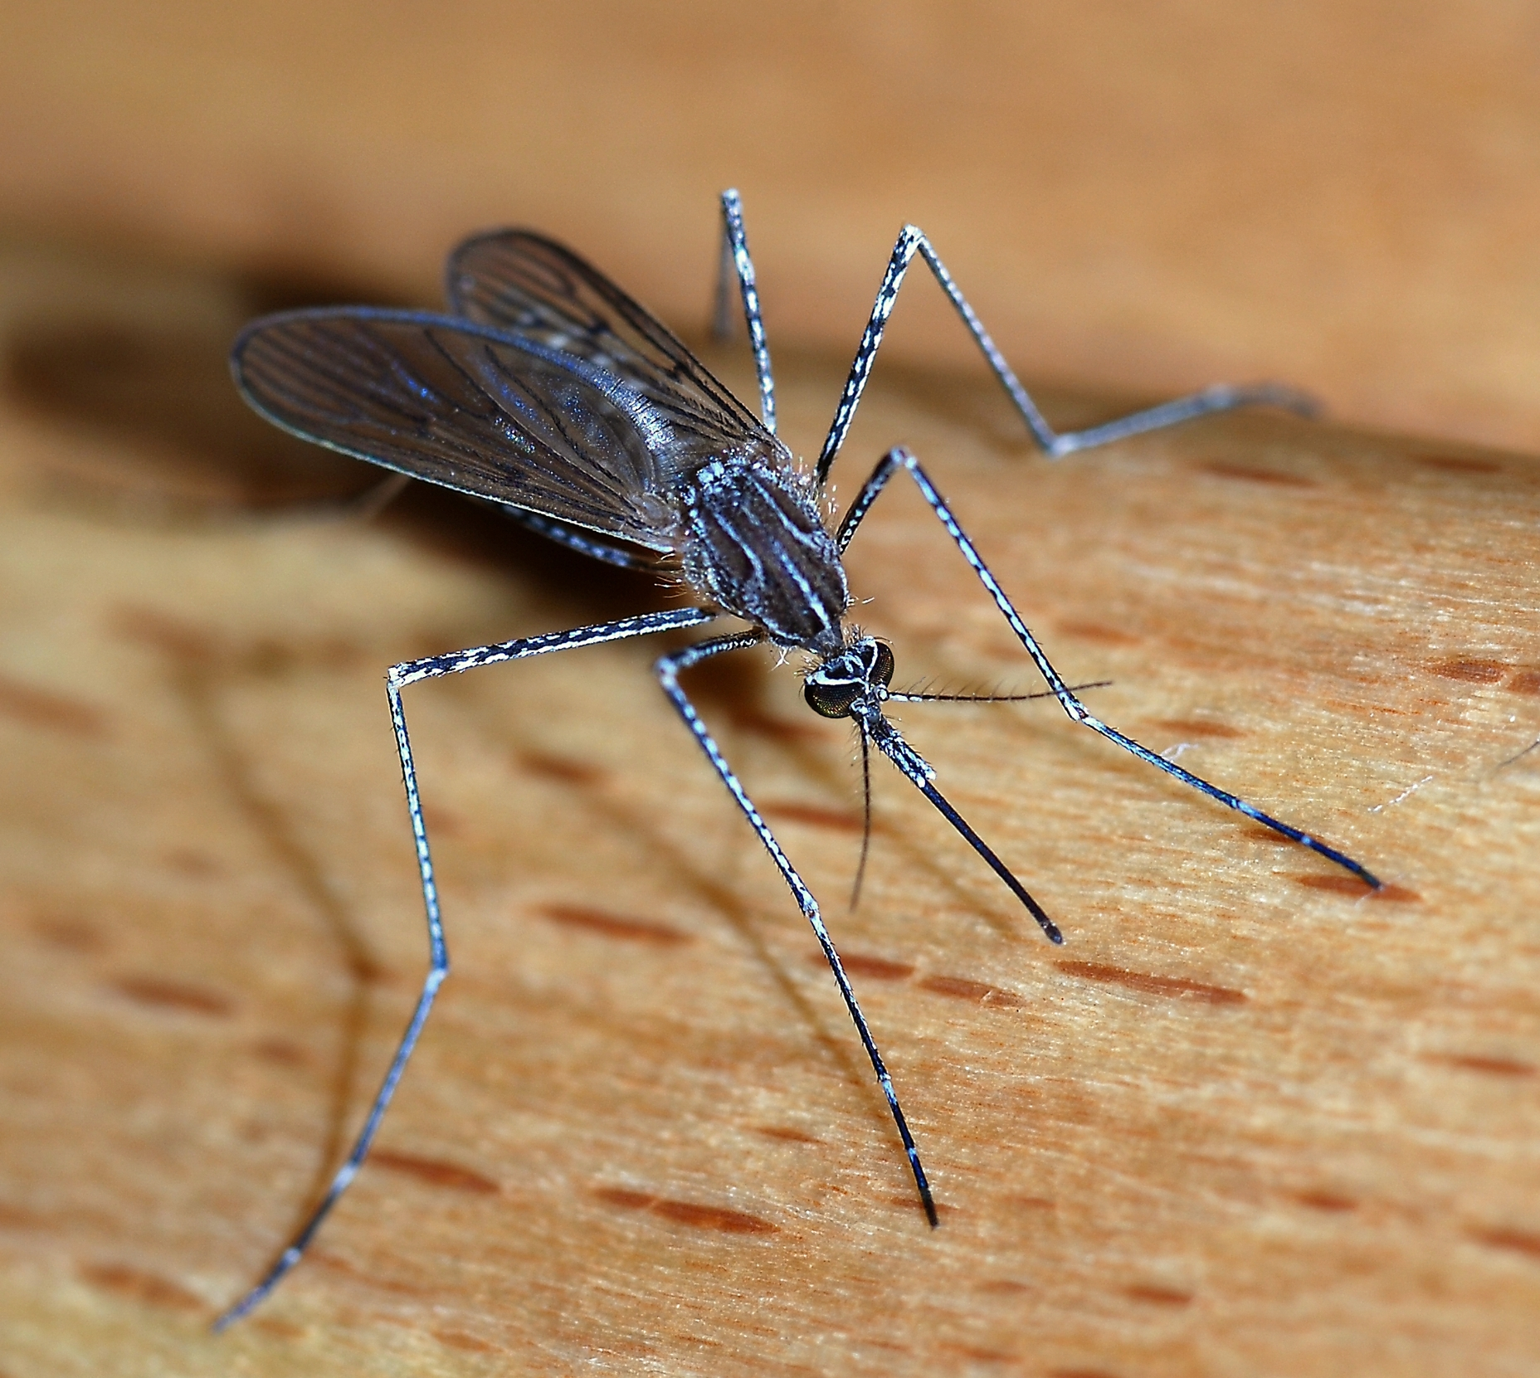
Preventive Measures
E. coli – sanitation
Tetanus - vaccine
AIDS – protected sex/ abstinence
Encephalitis – vaccine when applicable, avoid mosquito-heavy areas/ mosquito repellent

Slide 20
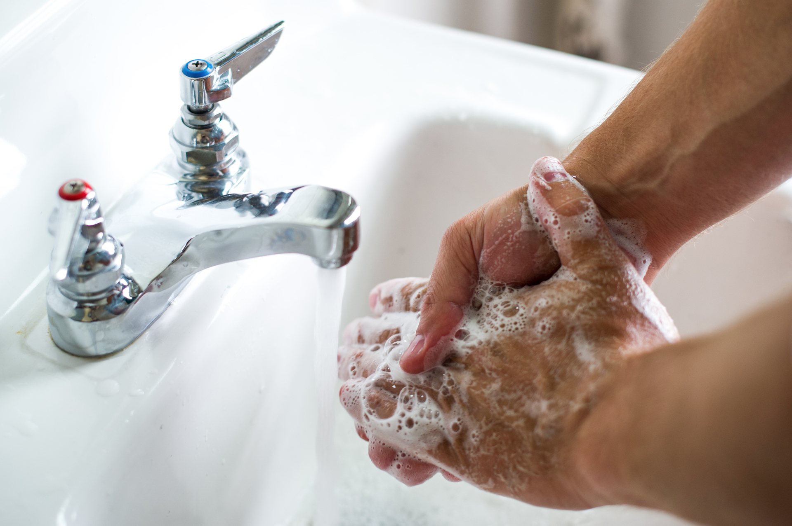
Preventive Measures
Salmonellosis – sanitation
Lyme disease – checking clothing for ticks, closed toe shoes
West Nile Virus – avoid mosquito-heavy areas, prevent stagnant water areas, repellent

Slide 21
Preventive Measures
Influenza – vaccine, hand washing
Meningitis – vaccine
Lead poisoning – keep buildings up to code, drink only safe water, regular calcium and iron in diet

Slide 22
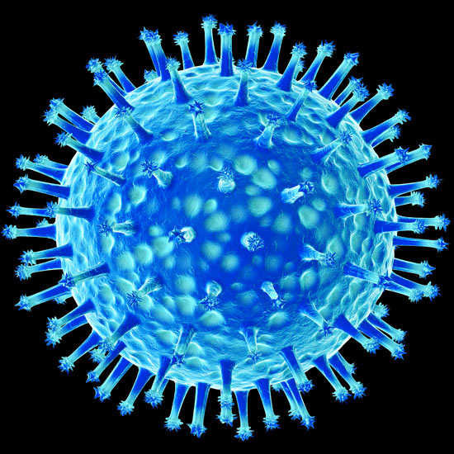
Influenza Virus

Slide 23
Immunization
Immunization, also known as vaccination or inoculation, is the process of stimulating the body to create antibodies against a disease. This gives you protection from the disease in the future.

Slide 24
Immunization
A sample of a weak, killed, or similar pathogen is introduced to the body. The body’s natural immune responses respond with protective antibodies to prevent future disease if exposed again.

Slide 25
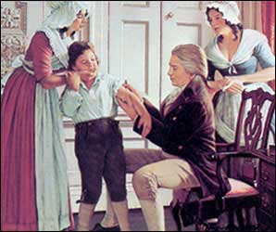
Edward Jenner

Slide 26
Immunization
Edward Jenner noticed that people who were previously ill with cowpox were protected from smallpox.
His observation formed the basis of vaccinations (vacca = cow in Latin)
Basic principle: Help your body help itself!

Slide 27
5 Diseases that should be Vaccinated against
Mumps
Meningitis
Rubella
Measles
Diptheria

Slide 28
Re-Immunizations
Not all vaccinations provide life-long protection.
Some vaccines need to be given “boosters,” like tetanus.
Others, like Influenza viruses, change from year to year through mutations. This is why you should get a flu shot every year.

Slide 29
Immunizations
There are some diseases that we cannot vaccinate against for a variety of reasons.
West Nile, E. coli, AIDS, some forms of encephalitis, salmonellosis, Lyme disease, lead poisoning (no microorganism involved) just to name a few.

Slide 30
Clean Water
Clean water is a major preventative measure in stopping the spread of disease.
Using dirty water can lead to cholera, dysentery, lead poisoning, and hepatitis.
Fortunately, several measures can be taken to clean water before use.

Slide 31
Clean Water
Boiling
Filtering systems
Iodine tablets
Chlorine for swimming pools
Hot water/dishsoap for cleaning

Slide 32
What are some ways you can help your campsite use only clean water?

Slide 33
Vectors
A vector is anything that can transmit a disease. Mosquitos, fleas, rodents, and bats are all examples of vectors. Some can be controlled, others are more difficult to regulate.

Slide 34
Vectors
What are some vectors that we can control in the community or campsite?
What vectors are more difficult to do so?

Slide 35
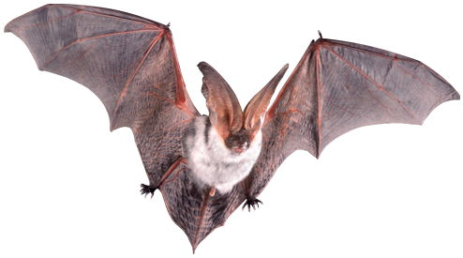
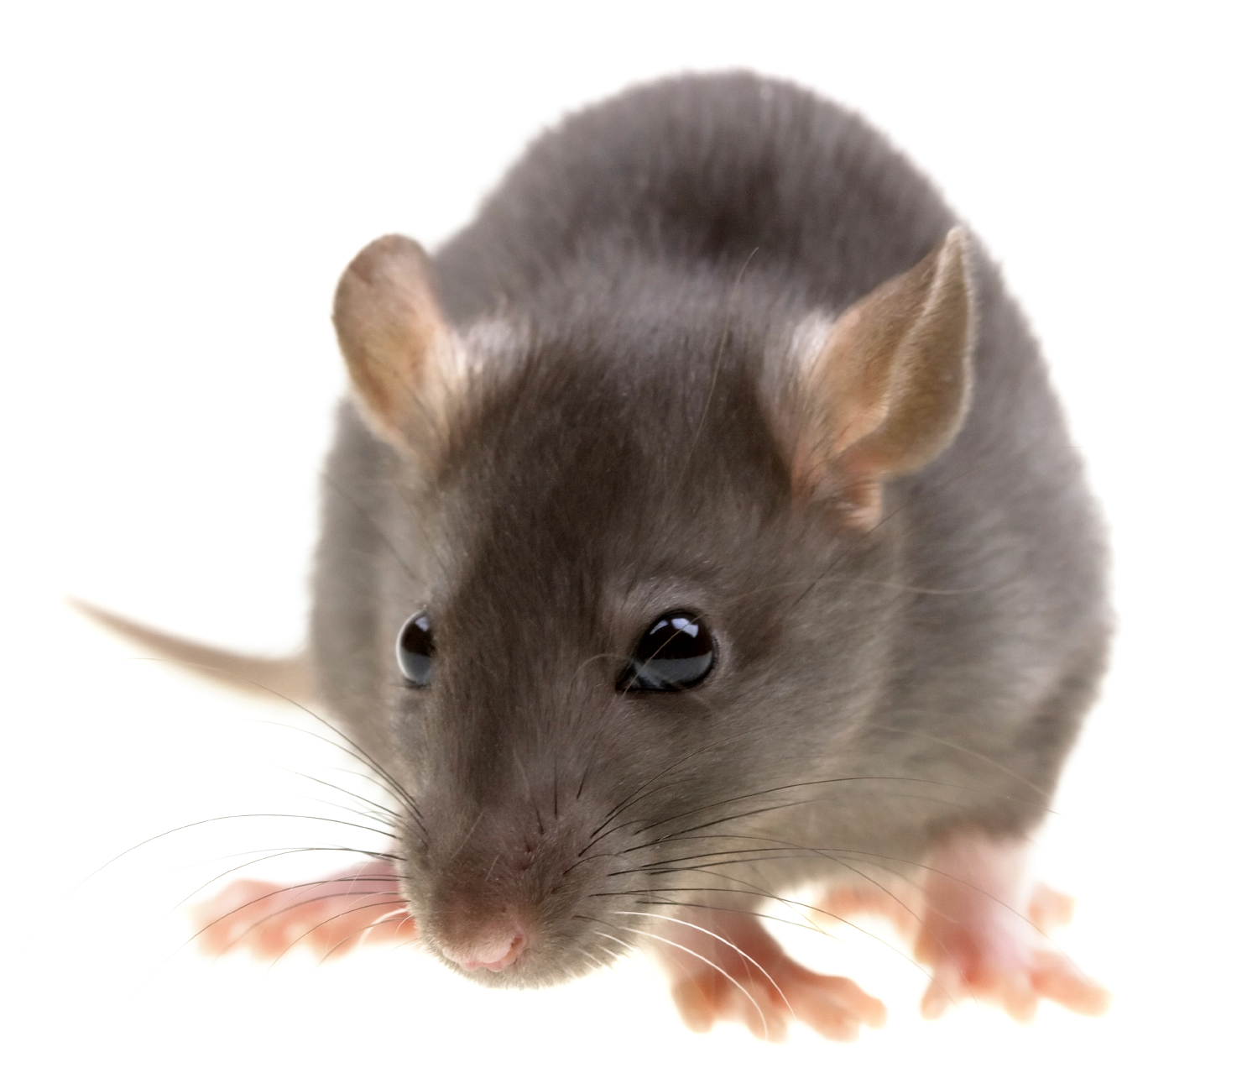
Vectors
Cleanliness can help with many insect vectors
Keeping campsite food in a bear bag can deter rodents
Eliminating stagnant water at a campsite or your home can lessen the amount of mosquitos.
Some factors are out of our control and the best we can do is avoid these vectors (Ex: bats!)

Slide 36
Group Activity
Visit food preparation facility on campus and observe proper preparation, storage, and handling of food. Notice what precautions are taken against microorganisms.

Slide 37
Pollution
Air
Water
Noise

Slide 38
Air Pollution
Particles in air or toxic gases can have serious health consequences.
Sources include wildfires, automobiles, factories, and power plants.
Can cause lung irritation, asthma attacks,

Slide 39
Activity: Public Health professional
Pay particular attention to:
Leading causes of death
Role of government health agencies
What kinds of public assistance are provided by these agencies

Slide 40
Picture Links:
http://www.reformation.org/james-phipps2.jpg
http://msutoday.msu.edu/_/img/assets/2013/hand-washing-photo.jpg
https://upload.wikimedia.org/wikipedia/commons/d/dc/Mosquito_2007-2.jpg
http://static.guim.co.uk/sys-images/Guardian/Pix/pictures/2012/5/2/1335968631853/Bird-flu-virus-001.jpg

