Slide 1
First Aid

Slide 2
How to Handle an Emergency
Check the Scene
Call for Help
Approach Safely
Provide Urgent Treatment
Protect From Further Injury
Treat Every Accident Victim for Shock
Make a Thorough Examination
Plan a Course of Action

Slide 3
Check the Scene
Stop and Look
Ask the Following:
What caused the accident?
Are there any dangers?
How many victims?
Are there bystanders who can help?
Is the scene safe for bystanders?

Slide 4
Call for Help
Call 911
What if you are in the wilderness?
Send a Messenger
Location of Victims
Description of Injury/Illness
Timeline of Accident
Treatment that was given
Requests: equipment, food, assistance, etc.
Notes:
Send a messenger

Slide 5
Approach Safely
Find a safe way to the victim
Do not become an accident victim yourself
Things to Remember:
Stay Calm
Communicate with Injured Persons
If location is unsafe:
It might be necessary to move victim
Warning: always stabilize the head and neck before moving
Note: serve those most in need first (Triage)

Slide 6
Provide Urgent Treatment
Urgent situation require smart and timely action
Consider Breathing and Bleeding first
Check for a pulse
Breathing
Conscious or Unconscious
Check the person to see if they are conscious
Tap them gently and ask if they need help
If unconscious, open the airway
Tilt the head and lift up the chin
Watch the chest and listen for breaths

Slide 7
Provide Urgent Treatment
Bleeding
Is there severe bleeding?
Check clothes for bleeding
Are there other contributing factors?
Medical Information Records
Example: allergies, diabetes, asthma, etc.

Slide 8
Protect From Further Injury
Only move the victim if it will not injure them further
Stabilize the Head and Neck

Slide 9
Treat Every Accident Victim for Shock
What is Shock?
Circulatory system does not provide enough blood and oxygen to the tissues of the body
Symptoms of Shock:
Restlessness or Irritability
Confusion, Fear, or Dizziness
Skin that is moist, clammy, cool, and pale
Quick, weak pulse
Shallow and irregular breathing
Nausea and Vomiting
Extreme Thirst

Slide 10
Treat Every Accident Victim for Shock
Symptoms of Shock:
Restlessness or Irritability
Confusion, Fear, or Dizziness
Skin that is moist, clammy, cool, and pale
Quick weak pulse
Shallow and irregular breathing
Nausea and vomiting
Extreme thirst

Slide 11
Treat Every Accident Victim for Shock
Treatment of Shock:
Manage Acute Symptoms
Bleeding, Breathing, Pain, and Wounds
Summon Emergency Aid
Monitor Victim
Have Victim Lie Down
Raise feet 12 inches above ground
Keep Victim Warm
Blankets, coats, and sleeping bags

Slide 12
Make a Thorough Examination
If professional help is delayed:
Conduct a more thorough examination
Do any injuries worsen?
Double check all injuries
How is their mobility?
Continue to observe any changes

Slide 13
Plan a Course of Action
Continue treatment and observation until help arrives
Keep the victim comfortable
Build a shelter around victim if needed
Be aware of your needs and those around you
Remain Calm

Slide 14
First Aid Supply and Skills
Personal First Aid Kit
Home or Patrol/Troop First Aid Kit
Moving an Ill or Injured Person

Slide 15
Personal First Aid Kit
It should allow you to provide initial care for serious emergencies
Adhesive Bandage (6)
Sterile Gauze Pads, 3x3 inch (2)
Adhesive tape (1 small roll)
Moleskin, 3x6 inch (1)
Soap (1 small bar) or alcohol-based hand sanitizing gel (1 travel size bottle)
Triple Antibiotic Ointment (1 small tube)
Scissors (1 pair)
Non-latex disposable gloves (1 pair)
CPR breathing barrier(1)
Pencil and Paper

Slide 16
Home or Patrol/Troop First Aid Kit
(a comprehensive first aid kit, greater quantity of items)
In addition to the items listed in your personal first aid kit:
Roller Bandage: 1” and 2”
Alcohol Swabs
Assorted Adhesive Bandages
Elastic Bandages (3” width)
Gel Pads (for blisters and burns)
Triangular Bandages
Tweezers
Safety Pins
Safety Glasses/Goggles

Slide 17
Moving an Ill or Injured Person
The decision to move an ill or injured person should be determined by the following:
Shock
Heart attack
Head, Neck, or Back Injury
Frostbitten or Burned Feet
Bone/Joint Injury (hip or below)

Slide 18
Single-Rescuer Assist
Shoulder Drag
Walking Assist
Ankle Drag
Blanket Drag

Slide 19
Single-Rescuer Assist Continued
One-Person Lift
Firefighter Carry
Pack-Strap Carry

Slide 20
Multiple-Rescuer Assists
Helping a Person Walk
Two-Handed Seat
Four-Handed Seat

Slide 21
Multiple-Rescuer Continued
Chair Carry
Hammock Carry
Stretchers

Slide 22
Minor Wounds and Injuries
Bruises
Puncture Wounds
Cuts and Scrapes (Abrasions)
Blisters on the Hand and Foot

Slide 23
Bruises
Color: Black and Blue
Most bruises can be treated with first aid
Treat with Ice or Re-Freezable Gel Pack
Wrapped in cloth
No longer than 20 min

Slide 24
Puncture Wounds
You should be aware that all puncture wounds can be hard to clean, and can easily become infected
To Summarize:
Clean the wound to the best of your ability
Use sterile first aid supplies
For Example: sterile tweezers for splinter removal; use sterile gauze to control bleeding
If the wound is severe, get the victim to a physician

Slide 25
Fish Hook

Slide 26
Cuts and Scrape (Abrasions)
Cuts – can be caused by knives, razors, and broken glass
Scrapes – caused when skin is scraped or rubbed off
Treatment
Clean – flush with clean water
Apply triple antibiotic ointment
Cover with a sterile bandage

Slide 27
Blisters on the Hand and Foot
Prevention
Noticing a hot spot is a signal to stop the activity immediately
Treatment
Moleskin
Treatment (if you must)
Wash the blister
Prick the lower edge
Press out the fluid
Apply a sterile bandage or a moleskin

Slide 28
Protection From Blood Borne Pathogens
Treat all blood as if it was contaminated with blood borne pathogens
Thoroughly wash your hands before and after treating a sick person
Wear protective gloves to stop bleeding, never use your bare hands
Properly and carefully dispose of all items that came in contact with blood
Always wash you hands/exposed skin with soap and warm water, or alcohol based hand sanitizer immediately after treating a victim even if protective equipment was used

Slide 29
Muscle, Joint, and Bone Injuries
Muscle Cramps
Sprains and Strains
Broken Bones
Head, Neck, and Back Injuries

Slide 30
Muscle Cramps
Occur when a muscle contracts on it its own, and does not easily relax
Common Causes:
Dehydration
Over Exertion
Depletion of Electrolytes (salt)
Poor stretching before physical activity
Treatments
Rest
Gentle Massage
Rehydration (H₂O/Gatorade)
Prevention
Stretch before exercise
Drink plenty of fluids before, during, and after you work

Slide 31
Sprain and Strain
Sprain
Strain
Occurs when ligaments of a joint have been overstretched
Example: ankle or wrist
Tender and painful
Show swelling and discoloration
Treatment: take the weight off of the injury and keep immobile, apply ice packs (<20 min)
Occurs when a muscle is overstretched
Example: hamstring
Tender during activity
Treatment: Rest

Slide 32
Sprain

Slide 33
Broken Bones
If you suspect there is a fracture, avoid movement and look for abnormal placement of a bone
Ask the Following:
Did you hear hear or feel a bone snap?
Do you feel pain when you press on the skin over the suspected break?
Are you unable to move the injured limb?

Slide 34
Closed (Simple) Fracture
Broken bone does NOT pierce the skin
Call 911
Protect the spinal column by supporting the victim’s head
Treat for shock

Slide 35
Open (compound) Fracture
Bone does pierce the skin and creates an open wound
Call 911
Do not try to clean the wound
Protect the spinal cord by stabilizing the head
Control Bleeding – place a sterile gauze around the wound
No direct pressure
Treat for shock

Slide 36
Splints
If a victim needs to be moved, splining might be necessary
Splints can help relieve pain and reduce further injury
Used to immobilize the injury
Placement of splint should be above and below the injury site
Make splints from whatever is handy: branches, neckerchief, etc.
Add cushion or padding

Slide 37
How to Splint an Injured Arm
Step 1: Keep area above & below still and stable
Step 3: Extend splints beyond joint while minimizing movement
Step 5: Check to make sure circulation hasn’t been cut off
Step 2: Check for circulation
Step 4: Secure splint with ties above and below injury

Slide 38
How to Splint and Injured Leg
Step 1: Provide support above and below injured area
Step 5: Tie the triangular bandages secure
Step 3: Position several triangular bandages under injured area
Step 4: Gently wrap padding around injured area
Step 6: Recheck for circulation
Step 2: With shoe still on check for circulation

Slide 39
Other Leg Splints
Lower-Leg Fracture
Upper-Leg Fracture

Slide 40
Administering Slings
Step1: Support injured area
Step 2: Check for circulation
Step 4: Tie upper free end and lower free corner in a knot behind the neck
Step 6: Tie the end of the bandage going under the uninjured arm and the end going around the back together
Step 3: Position triangular sling across chest
Step 5: To further stabilize bind the sling with a second bandage to the chest
Step 7: Recheck for circulation

Slide 41
More Slings

Slide 42
Head, Neck, and Back
The backbone is made of vertebrae that can break and result in a spinal cord injury.
Fractured vertebrae can be extremely dangerous because movement might cause further damage, paralysis or even death.
Spinal cord injuries are not easy to detect.
Could show signs pain, swelling, bruising, abnormally shaped
Or they may show now symptoms at all
Head injury symptoms (Can be acute or develop over time)
Disoriented
Irritable/confused

Slide 43
Head, Neck, and Back
When you suspect and injury to the head, neck or back.
Step 1: Stabilize the head and neck.
Step 2: Provide urgent treatment (bleeding, breathing, etc)
Step 3: Do not move the victim unless there is immediate danger (highway traffic, fire, etc)
Step 4: Only move the head if the victim is having trouble breathing.
Step 5: Treat for shock if necessary without moving the victim.
Never move the victim by yourself.

Slide 44
Cold and Heat Related Conditions and Injuries
Hypothermia
Frostbite
Dehydration
Heat Exhaustion
Heatstroke

Slide 45
Hypothermia
Occurs when a person body loses more heat than it can generate
Summon help and then treat
Causing factors
Inadequate dry/warm clothing
Dehydration, hunger and exhaustion
Bad weather (wind, rain, cold temperatures, etc)
Treatments
Drink warm liquids – non caffeine or alcohol
Seek shelter and change into dry, warm clothing
Monitor for changes in condition

Slide 46
Frostbite
A condition when the skin has been exposed to cold causing ice crystals to form in the tissue (fingers/toes, nose, cheeks, and ears)
Frostnip: Early stages of frostbite show grayish colored skin and numbness
Frostbite: Frostnip worsens as deeper layers of tissue are frozen and may lead to tissue death
Treatment
Carefully remove wet/frozen clothing
Rewarm the area with warm water
Do NOT rub or massage the frostbitten area
Get victim to a physician asap

Slide 47
Dehydration
Dehydration occurs when more water is lost than is taken in
Symptoms
Severe thirst accompanied with dry mouth
Dry skin
Nausea, dizziness, confusion, fainting, loss of appetite
Weakness, muscle cramps, decreased sweating
Less frequent and dark colored urine
Treatments
Drink plenty of water and sports drinks (Gatorade)
Have victim rest
If serious, seek medical attention

Slide 48
Heat Exhaustion
Can be brought on by a combination of dehydration and a warm environment
Signs Include:
Severe lack of energy, general weakness, headache, nausea
Sweating, cool, pale, moist skin, rapid pulse
First Aid
Get the person in the shade
Encourage the victim to drink small amounts of fluid (water or sports drink)
Apply water to the skin and clothing and fan the person to help the cooling process
If left untreated, heat exhaustion can develop into heat stroke

Slide 49
Heatstroke
Is more serious than heat exhaustion, can lead to death if not treated immediately
The body’s cooling system begins to fail and the person’s core temperature rises to life-threatening levels (above 105)
Heatstroke in the Young and Old
Dehydration and overexertion in hot weather
Exercise-Related Heatstroke
Hot, Sweaty, red skin, confusion, disorientation, and rapid pulse
Skin is hot and dry (no sweating)

Slide 50
Heatstroke
Call for medical assistance immediately
Lower the victim’s temperature
Move the person to air-conditioned or shady area
Loosen tight clothing and cool the victim with wet towels
If the person is able to drink, give the small amounts of cool water

Slide 51
Burns
Superficial (First-Degree) Burns
Partition –Thickness (Second-Degree) Burns
Full-Thickness (Third-Degree) Burn
Chemical Burns
Electrical Burns
Sunburn

Slide 52
Three Types of Burns

Slide 53
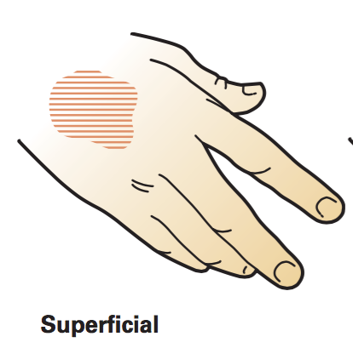
Superficial (First-Degree) Burns
“Mild” burns that will cause a painful reddening of the skin
Ex: touching a hot baking dish fresh out of the oven
They affect only the outer layer of the skin
Treatment
Hold the burn under cold water, or apply a cool wet compress, until the pain passes
Tip: be sure to get the victim away from the source of a burn before proceeding with treatment

Slide 54
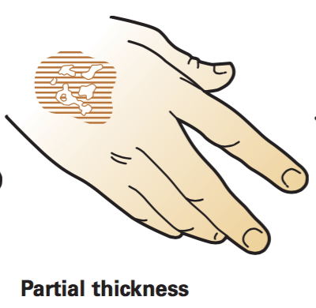
Partition –Thickness (Second-Degree) Burns
Affects the superficial layer of the skin, and the layer immediately below it
More serious than a superficial burns, and include a reddening and blistering of the skin
Example: being scalded by boiling water
Treatement:
Remove the person from the source of the burn
Cool the burned area with cold, running water, until the pain is relieved
Let the burn dry, then protect it with a loose, sterile gauze pad and bandage

Slide 55
Partial Thickness (Second-Degree) Burn

Slide 56
Full-Thickness (Third-Degree) Burn
Incredibly serious
Destroy the superficial and middle layers of the skin
Examples: Exposure to open flames, electricity, or chemicals
The skin may be burned away and the flesh charred
If the nerves are damaged, the victim may feel no pain
Do not try to remove any clothing
Treatment:
Cool the burn, cover the burned area with dry, sterile dressings, treat for shock, and seek immediate medical attention

Slide 57
Seek Immediate Medical Treatment if Burns:
Cause trouble breathing
Cover more than one body part or a large surface
Have caused possible burns to the airway (mouth and nose)
Affect the head, neck, hands, feet, or genitalia
Are full thickness, and the victim is:
Younger than age 5 or older than the age of 60
Are the result of chemicals, explosions, or electricity

Slide 58
Chemical Burns
Exposure of the skin or eyes to substances that are strong acids or strong bases
Examples: model glue, drain cleaner, metal cleaner, and battery acid
Step 1:
Use gloves to brush off chemicals from victim’s skin
Remove the clothing of the victim that still has chemicals on it
Do not contaminate yourself
Step 2:
Immediately flood the affected area with cool, clean water for at least 30 minutes

Slide 59
Chemical Burns
Step 3:
If the chemical is in the eye, flush the eye with clean water, acting as quickly as possible
Continue for at least 15 min or until medical professionals arrive
Step 4:
Cover the burns loosely with sterile dressing or gauze
Step 5:
Get medical help by calling 911
If you know the name of the chemical, provide it to the emergency workers

Slide 60
Electrical Burns
Too much electricity can even stop the heart from beating correctly
Superficial and partial-thickness burns may look like burns from too much heat, and the skin may be charred
Full-thickness electrical burns may not leave charred skin, the skin can look leathery, white, and hard to the touch
Shut off the source of the power and call an ambulance immediately
Step 1 – perform CPR if the victim is not breathing
Step 2 – cover the burns with sterile gauze pads, cool the burns
Step 3 – treat for shock

Slide 61
Sunburn
Most commonly type of first-degree burn, but prolonged exposure outdoors can lead to a second-degree burn
Repeated sunburns over a long period of time can cause skin damage and increase the risk of skin cancer
Treatment
Use a damp or wet cloth
Change the cloth frequently
Move the victim into the shade to prevent further injury
Best treatment is prevention
use sunscreen (SPF 15+) about a half-hour before sunlight exposure, and re-apply every two hours
Recommend clothing: broad-brimmed hat, long-sleeve shirt, and long pants

Slide 62
Burns
Superficial (First-Degree) Burns
Partition –Thickness (Second-Degree) Burns
Chemical Burns
Electrical Burns

Slide 63
Other First-Aid Cases
Fainting
Loss of Consciousness
Seizures
Diabetes
Foreign Object in the Eye
Nosebleeds
Dental Injuries
Puncture Wounds
Bites and Stings

Slide 64
Fainting
Fainting is a brief loss of consciousness
Caused by a temporary loss of blood flow to the brain
Causes: getting up too quickly, overheating or dehydration, emotional stress, or severe pain
Occurs suddenly, there are a few signs:
Dizziness, nausea, paleness, sweating, nubmness, and tingling of hands/feet
The victim may fall to the ground

Slide 65
Fainting
Treatment
Anyone who has fainted should be encouraged to stay lying down until they awaken and feels better
Raise the feet and legs about 12 inches
Make sure the person’s breathing passage (airway) stays open
If the victim begins to vomit, turn the perosn onto one side and keep the airway clear
If the person is alert enough, and possilby dehydrated, give fluids to drink
If the person does not awaken within two minutes, or fully recover after a few minutes, get medical help

Slide 66
Loss of Consciousness
Loss of consciousness for more than two minutes is a serious medical condition
Look for an emergency medical ID bracelet or necklace, or an information card that identifies health problems
Call 911 if the person is unconcious for man than two minutes
If there was an accident, protect the victim’s head and neck
If there was no accident, look for evidence of poisoning or drug use

Slide 67
Seizures
Change in awareness or behavior is caused by abnormal electrical activity in the brain
In children over 6 and adults, seizures are usually due to epilepsy (a disorder of the brain)
Can occur in a person who is suffering from a head injury, brain tumor, stroke, electrical shock, a high fever, low blood sugar, etc.
There is no first-aid measure that will stop a seizure, you can provide good first aid by protecting the person from being injured, during a seizure

Slide 68
Seizures
Step 1: move away furniture that could cause injury, avoid moving the person unless there is potential danger nearby (stairway or pool)
Step 2: Loosen tight clothing around neck and waist
Step 3: Do NOT try to hold the person
Step 4: Do not force anything into the mouth or between the teeth
Step 5: Make sure the airway remains open
Step 6: When the seizure is over, place the person in a recovery position
Step 7: Let the person rest
Step 8: If the person is not know to have epilepsy, if the serious lasts more than 5 minutes, or is slow to recover, call 911

Slide 69
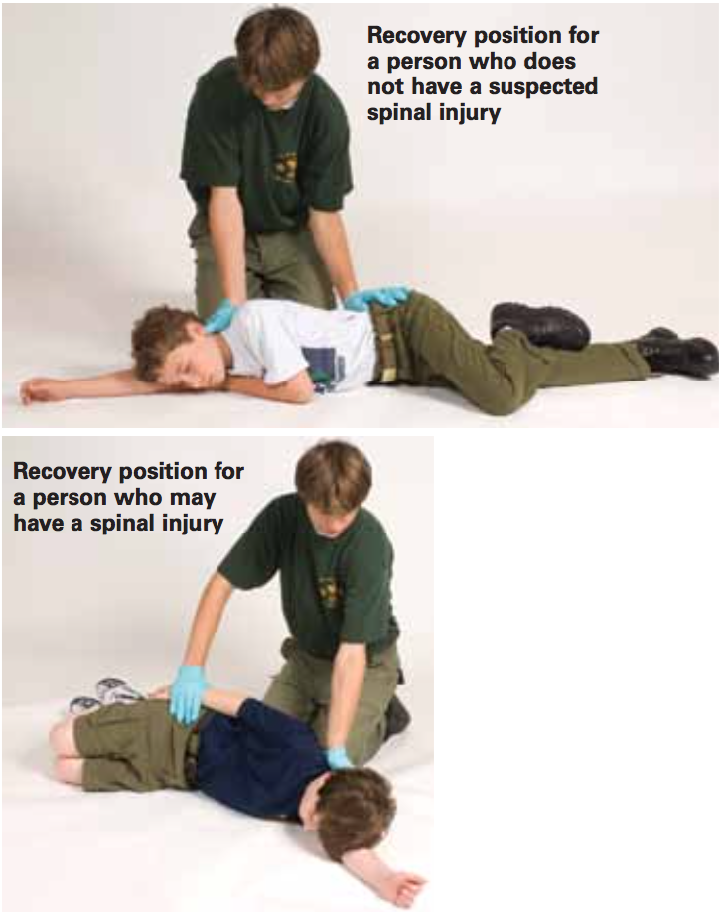
Seizure Recovery Position

Slide 70
Diabetes
A disorder impairing the body’s ability to control its blood sugar level
Some conditions require injections of the hormone Insulin, which helps the body use sugar for energy
People who use insulin must maintain a proper sugar level
When a diabetic has a blood-sugar level that is too high or too low, the person can become unconscious
Low blood sugar (hypoglycemia) is extremely dangerous and can cause permanent brain damage if not treated quickly
A diabetic person may be wearing a medical ID necklace/bracelet

Slide 71
Diabetes
Warning Signs:
Hypoglycemia: headache, sweating, pale and moist skin, weakness, dizziness, shallow breathing, and a rapid pulse
Hyperglycemia: extreme thirst, frequent urination, drowsiness, lack of appetite, and labored breathing

Slide 72
Foreign Object in the Eye
Something in the eyes is not just painful – it could endanger eyesight
Always wear safety glasses or goggles when using power tools, lawn, and garden equipment
Avoid fumes from cleaning agents from burning your eyes
If a foreign object gets in the eye, do NOT rub the eye, as you could damage the eye
Have the person blink the eyes, and then try to flush out the foreign particles with clean running water, or clean glass/bottle
If the object does not wash out, it must be treated by a physician
Stabilize the eye with a dry, sterile gauze pad
Take the person to a doctor

Slide 73
Nosebleeds
Nosebleeds look bad, but normally they are not serious, and usually stop in a few minutes
The bleeding usually results from a small vein in the nose and can be caused by irritation
Colds, allergies, picking, cold and dry weather, and overuse of nose spray
Treatment:
Have the victim sit leaning slightly forward so that the blood does not run down the throat
Ask the person to pinch the nose firmly but gently, and apply the pressure on the upper lip, just below the nose
Apply a cold compress to the nose and surrounding area
After 10 min, check if the bleeding has stopped, if after 15 min the bleeding continues, then seek medical attention

Slide 74
Abdominal Pain
Many causes that could be harmless (upset stomach) or dangerous (appendicitis)
Always take complaints about abdominal pain seriously
Watch the person for increasing pain or changes in levels of consciousness
Appendicitis: First there is a loss of appetite, pain in the lower right quadrant, then nausea and vomiting
Do not let the person eat or drink, call 911

Slide 75
Poisonous Plants
Poison Ivy, Poison Oak, and Poison Sumac produce oily sap that irritates the skin of most people
It can spread to other parts of the body and cause a rash with redness, blisters, swelling, itching, burning, fever, and fever
The severity of the reaction depends on the the individual and the extent of the exposure
The best form of prevention is to learn how to recognize the poisonous plants and avoid contact
The plants must be on your skin for 10-20 minutes before it starts to cause problems
If you think you touched a poisonous plant: immediately stop to wash the exposed area with soap and water, wipe with rubbing alcohol and apply calamine
If the reaction is severe or the genitals are affected, seek medical attention
Be sure to change your clothes

Slide 76
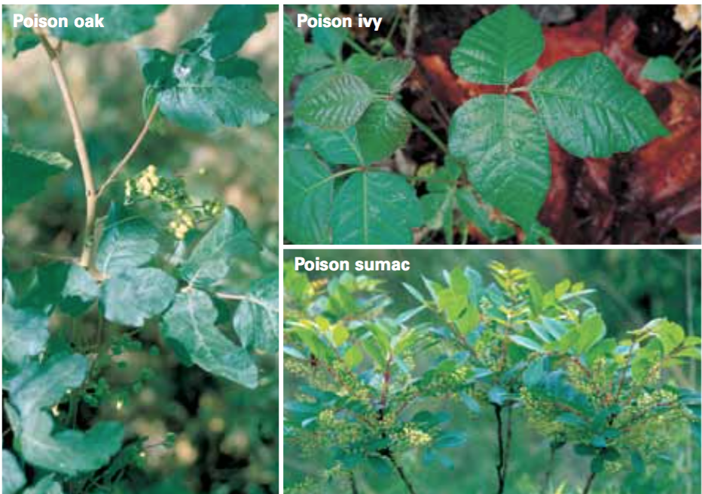

Slide 77
Dental Injuries
A blow to the face can knock out a tooth or break a jaw
An affected tooth with pain, fever, or swelling can be just as serious
Braces and Retainers
If a wire is causing irritation, cover the end of the wire with a small cotton ball or gauze
If the wire is embedded in the cheek, tongue, or gum, do NOT attempt to remove it, see the dentist immediately
Bitten Lip or Tongue
Apply direct pressure to the bleeding area with a clean cloth
If there is swelling, apply a cold, wet cloth or pad

Slide 78
Dental Injuries
Toothache
Have the victim rinse the mouth vigorously with warm water (to clean out debris); if there is swelling place a cold, wet cloth or pad on the outside of the cheek, have the person see the dentist immediately (possible infection)
Broken, Chipped, or Loosened Tooth
Gently rinse the mouth with warm water, place a wet cloth or pad in the area, see a dentist and take the chipped piece of tooth along
Knocked-out Tooth
Pick up the tooth by the crown, rinse under cold water or milk, do not rub or allow the tooth to dry, flush the wound with clean water or saline
Take the victim and tooth to the dentist within 30 minutes
Possible Fractured Jaw
Keeps the jaw from moving by using a handkerchief, necktie, towel
Use a cold wet cloth if there is swelling; call a dentist and visit the emergency room

Slide 79
Bites and Stings
Insect bites are irritating but are usually not dangerous
Ticks
Always inspect yourself after walking in area with tall grass and brush
Ticks burry their heads beneath the skin
Remove them by using tweezers near the skin and then wash with soap
Black Widow Spiders
Red hourglass mark on its underside
These spiders commonly dwell shadowy spots like barns and garages
A bit can cause redness, sharp pain, nausea and muscle spasms
Treat seek medical attention immediately

Slide 80
Bites and Stings (continued)
Brown Recluse Spider
Violin shaped mark on its back
Hide in shadowy areas
Bites cause swelling, blistering, fever, nausea, joint pain
Treat by washing bite and seek medical attention immediately
Fire Ants
If disturbed fire ants will likely swarm
Bites can cause pain and blisters
Treat by washing injured area with soap and water and cover with bandages

Slide 81
Bites and Stings (continued)
Bees
Treating a Bee Sting
Remove stinger by scraping it out with a knife blade
Don’t squeeze the stinger- will force out more venom
Use ice pack to help reduce pain and swelling
If victim is allergic seek medical attention immediately
Common Scorpion
Stings cause sharp pain, swelling and discoloration but generally no lasting ill effects
Treat with ice pack to relieve itching and pain
If victim is allergic seek medical attention immediately

Slide 82
Animal Bites
Bites from animals can cause serious puncture wounds
May be infected dangerous illnesses like rabies
Treating an Animal Bite
Wash are with soap and water
Control the bleeding and cover with a sterile bandage
Seek medical attention
Report an bites to public health authorities

Slide 83
Rabies

Slide 84
Snakebites
Bites from non venomous snakes cause only minor puncture wounds
North American venomous snakes include pit vipers, rattle snakes, copperheads and cottonmouths
Pit viper
Have triangular shaped heads
Bites cause swelling, skin discoloration, nausea, vomiting, blurred vision, shallow breathing
Coral snakes
Have black noses and marked with red then yellow then black bands
Powerful venom causes slowed physical and mental reactions, sleepiness, nausea, shortness of breath, shock and coma

Slide 85
Snakebites (continued)
Treating the bite from a venomous snake
Step 1: Get the victim to medical care immediately
Step 2: Remove jewelry that might cause problems is the bits swells
Step 3: When waiting for medical attention wash the wound
Step 4: Keep the victim calm and comfortable and position the bite lower than the rest of the body
Step 5: Treat for shock if necessary
Do NOT make any cuts or apply suction to the bite or apply a tourniquet – Could cause further harm to the victim

Slide 86
Life-Threatening Emergencies
Heart Attack
Stroke
Chocking
Severe Bleeding
Anaphylactic Shock (Anaphylaxis)

Slide 87
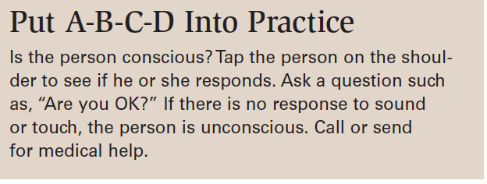
Life Threatening Emergencies
The right first aid given quickly can save a life
People who may need life saving include
Heart attacks
Deep cuts with severe bleeding
Near-drowning
Lightning strikes
An easy way to remember the order of treatment is A-B-C-D. Airway, Breathing, Circulation, and Defibrillation

Slide 88
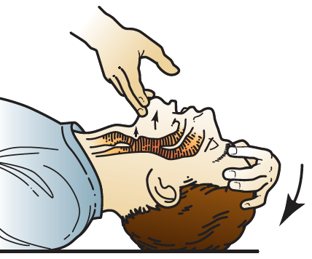
A is for Airway
The airway is the passage that air enters the mouth/nose to reach the lungs
If the victim vomits protect the airway by turning the victim on their side
If the victim is unconscious position them on their back, tilt their head back and lift the chin to keep the tongue from blocking the airway

Slide 89
B is for Breathing
After opening the airway check to see if the victim can breathe normally
Look, listen and feel for movement of breathing
If there are no signs of breathing, give two rescue breaths, then begin Cardiopulmonary Resuscitation (CPR)

Slide 90
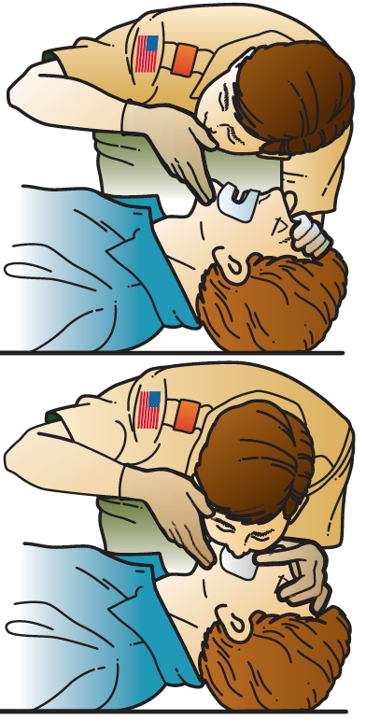
CPR
Step 1: Place a breathing barrier over the victims mouth
Step 2: Give two rescue breaths while maintaining proper head tilt and make sure airway is open by observing the rise and fall of the chest with each breath
Step 3: For a child/infant in between cycles of two rescue breaths check their pulse for no longer than 10 seconds and recheck the pulse every 2 minutes
For an Adult after two rescue breaths, begin CPR immediately

Slide 91
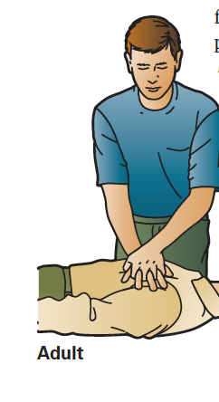
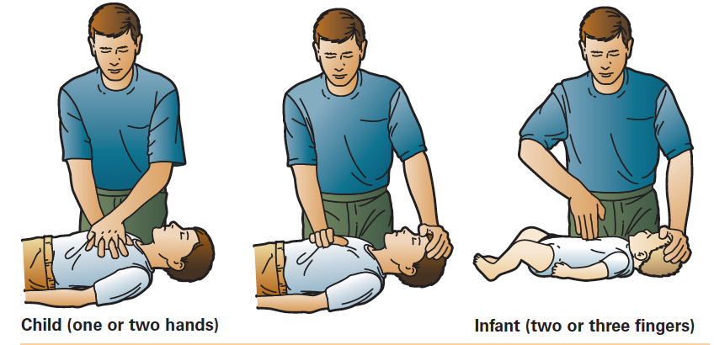
C is for Circulation
Signals of circulation means that heart is pumping blood throughout the body
If there are no signs that the heart is beating, begin CPR immediately
Accidents that cause victims to stop breathing can also stop their heart
Begin CPR is the victim does not breath on their own after receiving two rescue breaths
Learning CPR can be provided by trained instructors (Red Cross)

Slide 92
D is for Defibrillation
The heart is made of many muscle fibers that contract in unison
During a heart attack the heart muscles do NOT fire in unison (cardiac arrest)
Defibrillators send electrical shock through the heart to help restore and effective heartbeat (rhythm)
Most hospitals, ambulances, and emergency care facilities are equipped a with Automated External Defibrillator (AED)
AEDs check the victims heart rhythm, and advise rescuers when a shock is needed.
Proper training must be issued before using an AED

Slide 93
Heart Attack
Condition when there is damage to the heart muscle
Common Warning signs
Feeling of heavy pressure on the chest
Unusual sweating
Nausea
Shortness of breath
Feeling of weakness
Should anyone complain of these symptoms seek medical attention as soon as possible

Slide 94
Stroke
Occurs when and artery in the brain bursts or is blocked by a clot interrupting blood supply resulting in brain cell death.
Common warning signs
Sudden weakness or numbness in the face, arm, or leg
Sudden confusion or trouble speaking
Sudden trouble seeing
Sudden dizziness with loss of balance
Sudden severe headache
If you think someone might be having a stroke call 911 immediately

Slide 95
Think Fast (Stroke)

Slide 96
Choking
Caused when an object is blocking the air way
Common warning signs
Victim may grasp their throat
Unable to breathe or speak
If someone is choking call for help and then do the following
Step 1: Give a series of back blows with the palm of your hand
Step 2: Stand behind victim and clasp your hands just above their navel
Step 3: Thrust you hands upward to pop loose obstruction
Step 4: Repeat steps 1-3 until obstruction is cleared

Slide 97
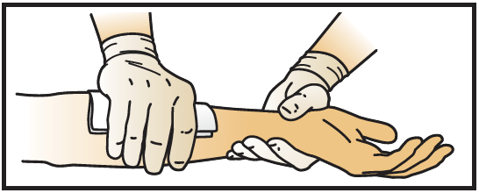
Severe Bleeding
Caused when a large blood vessel is cut resulting in large amount of blood loss occurs
Treating Severe Bleeding
Step 1: Put on personal protective equipment (latex gloves) and apply pressure on the wound with a bandage
Step 2: After bleeding stops secure the bandage with sterile pads and athletic tape. Make sure you have not cut off the circulation
Step 3: Periodically check for circulation
Step 4: If bandage becomes soaked with blood, apply a fresh bandage on top of the first one and apply pressure.

Slide 98
Tourniquets
A device that is designed to tighten on a limb above the site of a major bleed (strip of cloth)
This method should only be used if all other efforts to stop severe bleeding have failed
A tourniquet should be loosened periodically to check if the bleeding has stopped and to avoid causing permanent damage to the tissue, blood vessels and nerves
For any case of severe bleeding summon emergency medical help immediately

Slide 99
Anaphylactic Shock
Allergic reaction caused by bee, wasp, and insect bites and stings, or certain foods
Common Warning Signs
Redness, swelling of throat, tongue – can obstruct the airway
Treatment
Step 1: Call 911
Step 2: Check victim for ID or information cards and provide lifesaving treatment if necessary (A-B-C-D)
Step 3: See that the victim receives follow-up medical treatment

