Slide 1
CHEMISTRY
http://www.scouting.org/scoutsource/BoyScouts/AdvancementandAwards/MeritBadges/mb-CHEM.aspx
Notes:
http://www.odekirk.info/RESOURCE/CHEMISTRY/PHAM.pdf
http://www.scouting.org/filestore/Merit_Badge_ReqandRes/Chemistry.pdf

Slide 2
OUTLINE
Describe three examples of safety equipment used in a chemistry laboratory and the reason each one is used.
Describe what a material safety data sheet (MSDS) is and tell why it is used.
Obtain an MSDS for both a paint and an insecticide. Compare and discuss the toxicity, disposal, and safe-handling sections for these two common household products.
Discuss the safe storage of chemicals. How does the safe storage of chemicals apply to your home, your school, your community, and the environment?

Slide 3
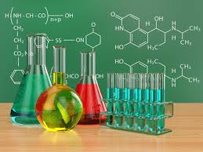
What is Chemistry?
llll
Chemistry is the study of matter: its composition, structure, properties, and reactivity
So what is matter?
https://assignment.essayshark.com/blog/chemistry-poblem-solver-for-your-academic-success/
Notes:
Matter is anything that has mass and occupies space.

Slide 4
The Building Blocks of Life
Chemicals are made of molecules.
Molecules are made of atoms.
Two million atoms can fit on the tip of a pin!
Example: Water (H₂O)
http://www.dreamstime.com/stock-images-h2o-water-molecule-image4763154

Slide 5
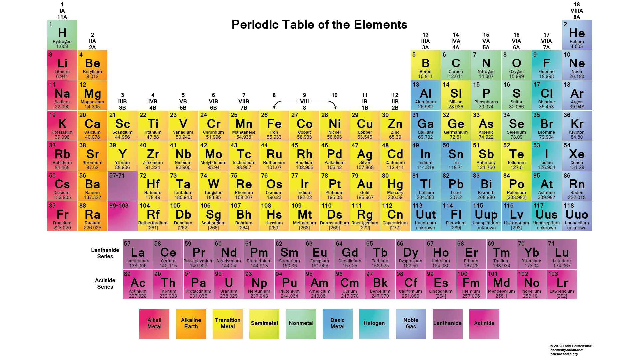
Notes:
Point out the groups:
Column 1 (Pink) = Alkali metals
Column 2 (orange) = alkaline earth metals
Column 3- 12 (yellow) = transition metals
Puke green = metalloids (share properties of both the metals and nonmetals)
Green = non-metals
Column 17 (Green-blue) = Halogens
Column 18 (Blue-purple) = Noble gases

Slide 6
Section 1: Lab Safety and Storage

Slide 7
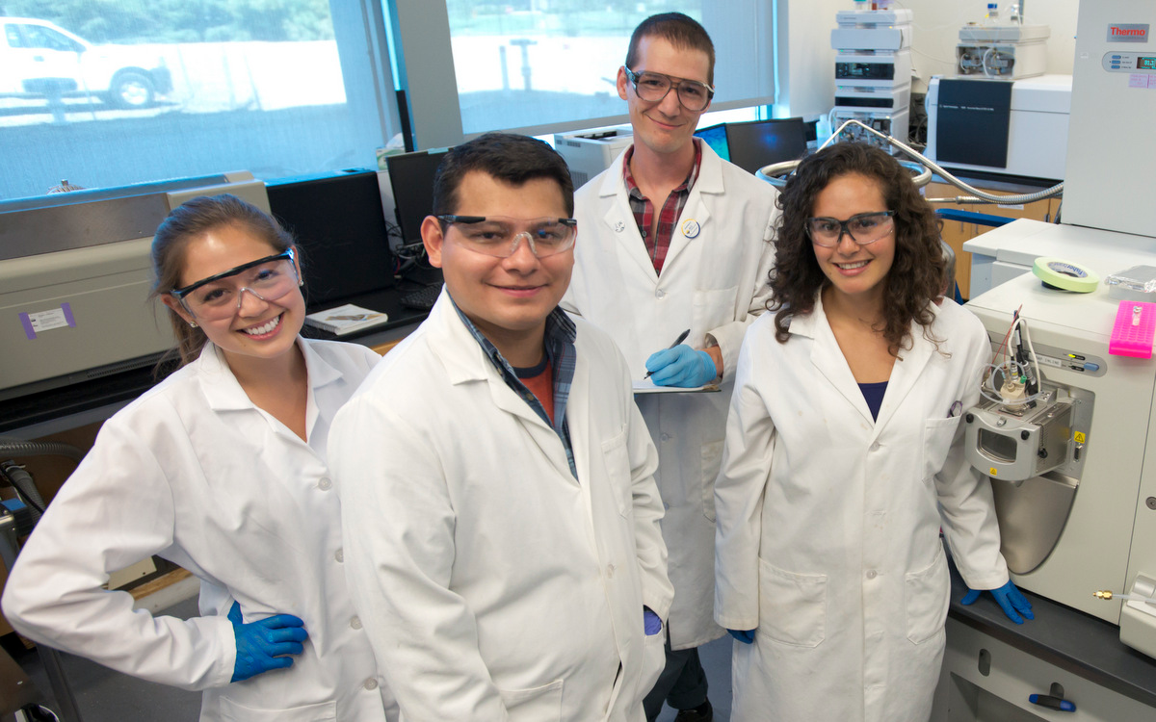
Chemistry Laboratory Safety Materials
Lab Coat
Safety Goggles
Long pants and closed-toe shoes
Safety Gloves
http://chemistry.ucdavis.edu/graduate/prospective_students.html

Slide 8
Material Safety Data Sheet (MSDS)
Gives users the safety information of a certain chemical.
Gives medical/emergency personnel the correct procedures for cleaning and treating a chemical spill/exposure.
Occupational Safety and Health Administration (OHSAH) monitors the exposure to chemicals in the workplace and MSDS reporting
WHAT TO LOOK FOR ON A MSDS
Toxicity and Health Effects
First Aid
Reactivity
Storage
Disposal
Protective Equipment
Spill and Leak
Physical Data
Notes:
In the case of a spill or injury in a chemistry lab – must report it with an MSDS.

Slide 9
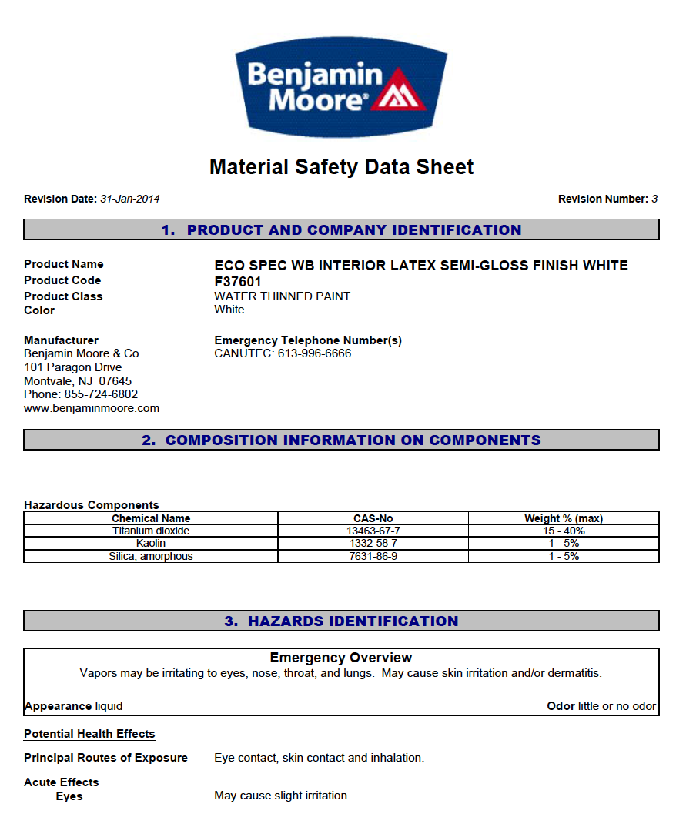
MSDS EXAMPLES (www.ohsah.bc.ca )
PAINT
INSECTISIDE
http://msds.ohsah.bc.ca/msds_files/4170.pdf
Benjamin Moore Paint
http://msds.ohsah.bc.ca/msds_files/15215.pdf

Slide 10
Storing Chemicals Safely
STORAGE IN YOUR HOME
Childproof locking devices on cabinets
Read the label!
STORAGE IN YOUR SCHOOL
Storage organized by hazard classification
Teachers receive special training for storage, use, hazards, and disposal
Chemical spill plans in case of accident
STORAGE IN YOUR COMMUNITY
Businesses can use hazardous chemicals
Can be toxic if not stored properly
What would happen if there is a chemical spill on a business property?
Government Regulations
NEVER STORE A CHEMICAL IN A CONTAINER THAT WAS NOT MADE FOR IT!!!
Notes:
What would happen if there was chemical spill on a business property?
Could be washed by the rain into a local stream and drain into the town’s water supply
Government regulates the proper use, storage, and disposal of chemicals.

Slide 11
Section 2: Reactions.. the fun stuff!

Slide 12
Fe (s) + CuSO₄ (aq) → FeSO₄ (aq) + Cu (s)
Iron Nail placed in a copper sulfate solution
Single displacement reaction
Video: https://www.youtube.com/watch?v=T3he8_e-wkw
http://www.harpercollege.edu/tm-ps/chm/100/dgodambe/thedisk/chemrxn/7perform.htm

Slide 13
Separation Techniques
How would you separate…
Sand from water?
Table salt from water?
Oil from water?
Gasoline from motor oil?

Slide 14
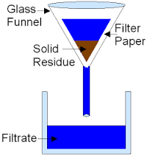
1. Separating Sand from Water
Filtration
A process that works like a net to catch particles that are too large to pass through.
Water passes through the ‘pores’ of the filtration device and the sand particles do not pass through. The sand will stay within the filter.
A coffee filter is a great filtration device.
At Home Example: your mom is cooking spaghetti noodles and she drains the water from the noodles.
Environmental Example: Water treatment!
http://www.gcsescience.com/e5-filter-paper.htm
Notes:
Explaining the picture:
You have a glass funnel in which you place a filter paper in (filter paper looks a lot like a coffee filter)
You pour your (water + sand) into the filter paper
The sand will stay in the funnel (solid residue) while the water will pass through into the beaker (Filtrate)

Slide 15
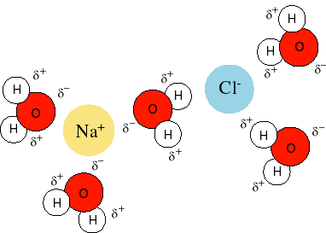
2. Separating Table Salt from Water
Table Salt (NaCl) will dissolve in water. The positive charge of sodium (Na⁺) interacts with the negative charge on oxygen molecules of water. And the negative charge of chloride (Cl⁻) binds with the hydrogens. LIKE DISSOLVES LIKE!
When the salt dissolves in the water, this product is called a SOLUTION.
http://www.public.asu.edu/~laserweb/woodbury/classes/chm341/lecture_set6/lecture%20set6.html
Answer: Use their different boiling points by using a technique called Distillation! Water has a much lower boiling point than NaCl.
What is a boiling point?
Distillation is the process in which a liquid mixture of 2 or more substances is separated by adding or removing heat.
To separate water and salt, one would heat the mixture to water’s boiling point to where it evaporates and just salt is left.
So how do we separate the salt from water?
Filtration would not work.
Hint: Use the different physical properties of salt and water
Notes:
The boiling point is the temperature at which a substance boils at atmospheric pressure.

Slide 16
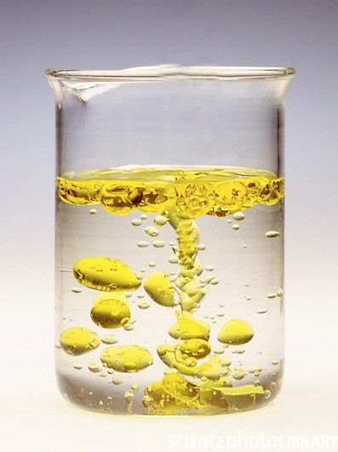
3A. Separating Oil from Water
Notice how the oil and water are separating. The oil separates out on top because of various factors:
Oil has a lower density than water. Thus, it will float to the top.
- Note: Density is the mass per unit volume of a substance.
D = M
V
Water is a polar molecule and oil is nonpolar.
- Polarity occurs when a molecule has both positive and negatively
charged atoms.
- Because opposites attract, these water molecules want to bind to
one another.
- This attraction causes cohesion – water pulling together.
- Because oil is nonpolar, it will not be attracted to the water
molecules. Thus, it will not dissolve in water.
REAL WORLD APPLICATION: SEPARATING CRUDE OIL FROM WATER AS IT COMES OUT OF THE GROUND
http://viralfacts.org/science/why_oil_and_water_don%E2%80%99t_mix.html
Notes:
Best way to remember density = M/V looks look a heart.

Slide 17
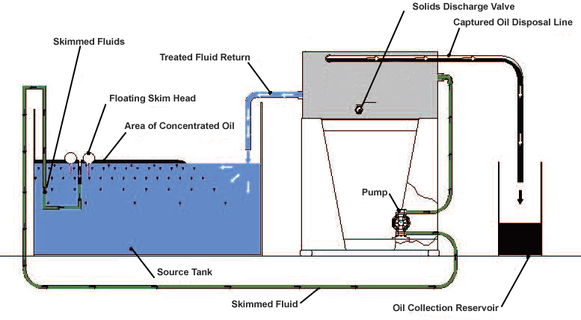
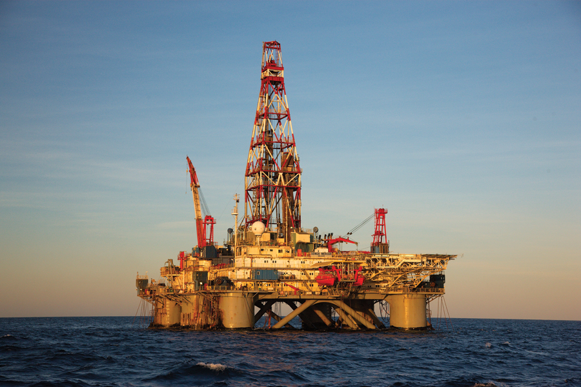
3B. Separating Oil from Water
Separating crude oil from water:
The oil brings water with it as it comes up from the ground.
Cars cannot run on water so you must separate the two substances.
http://www.ecologixsystems.com/oil-water-separator-skimloop.php
Oil-Water Separator:
Like a large bottle on its side with a wall that divides the separator.
Water and oil fill up one section and the oil separate to make a top layer.
Some of the oil spills over the top of the wall and into the second section and is then drained out.
Then the water is drained from bottom of the first section
http://www.drillingcontractor.org/drilling-completion-news-15-23888
Notes:
Find better picture of oil-water separator
At home experiment: you can fill a disposable cup with half olive oil and half water. Let the oil and water separate into two layers. Poke a hole on the side and near the bottom of the cup. Watch the water flow out of the drain hole. Just like it would in an oil water separator.

Slide 18
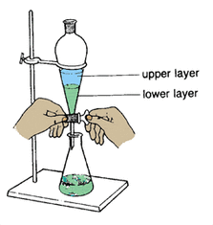
In the Chemistry lab, we use a separating funnel to separate water from oil.
Here’s how you do it:
Secure the separating funnel on the clamp and stand and make sure that tap is closed.
Pour your mixture into the funnel.
Remove the funnel from the clamp and shake it gently. Then put it back, securing it to the stand.
The oil will make up the upper layer while the water makes up the lower layer.
Slowly open the tap to allow the water to drain into the flask.
Close the tap when all the water has drained into the flask and just the oil is left in the funnel.
CLAMP
SEPARATING FUNNEL
STAND
FLASK
http://purificationmtang.weebly.com/separation-funnel.html

Slide 19
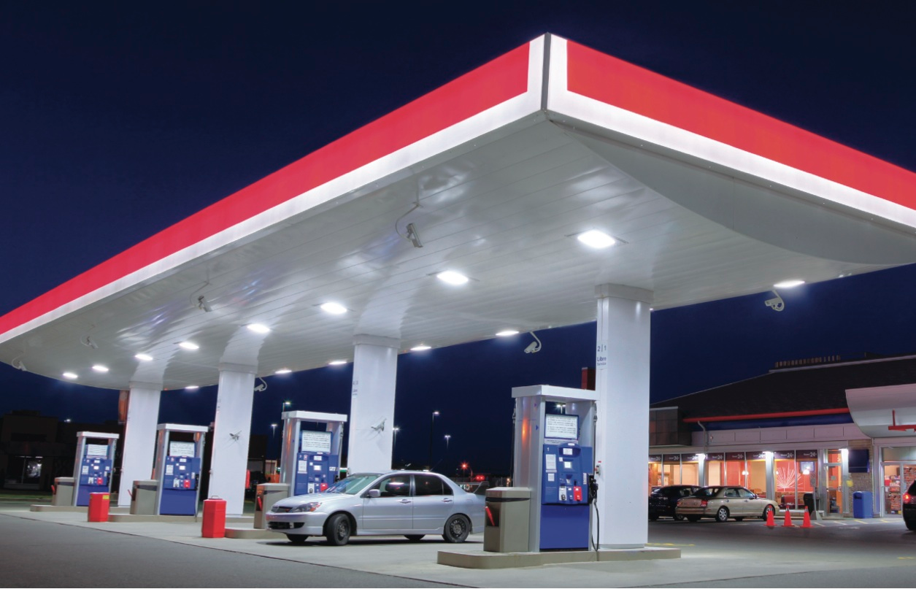
4. Separating Gasoline from Motor Oil
Gasoline is a refined product from crude oil. Crude oil cannot be used directly so it must be refined into gasoline in order for us to use it in our vehicles.
After crude oil has been refined and gasoline is produced, there is still a mixture of the gasoline and oil.
These two products are very similar in chemical properties.
Therefore, they form a solution. Just like salt and water.
LIKE DISSOLVES LIKE!!!
To separate gasoline and oil you would use the Distillation technique, like we previously discussed.
Oil has a much heavier weight than gasoline, so it has a higher boiling point. Therefore, it will evaporate after the gasoline does.
http://precisionpaymentsinc.com/gas-stations/
Notes:
Pg. 62-63

Slide 20
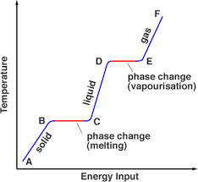
Chemical Reaction vs. Physical Change
Chemical Reaction
The atoms in a molecule are combined or rearranged with atoms of another molecule.
The product is a new compound that has different physical and chemical properties.
Physical Change
Physical changes do not form a new compound.
It is simply a change from one state to another of a single compound.
The different states include:
Solid, Liquid, and Gas
A compound changes to these states once it reaches either its boiling or freezing points.
Physical changes also include change in shape and color of a compound
http://www.splung.com/content/sid/6/page/latentheat
Notes:
Use the graph to discuss boiling and freezing points and how the relate to the change in states.

Slide 21
Cartesian Diver
Why did it sink when you squeezed the bottle?
The water pressure increases and the air bubble inside the diver
Liquids are incompressible because their volume does not change when pressure changes
The diver initially floats (like a boat!) because of buoyancy, the force that equals the weight of the water displaced by the volume of the diver.
When pressure increases (the squeezing) the trapped air bubble compresses and that air displaces less water.
So now the force of gravity is greater that the buoyant force
Therefore, the diver sinks!
Notes:
https://sciencebob.com/make-a-cartesian-diver/
Construct a Cartesian diver: CONSTRUCT THIS BEFORE CLASSES START. LOOK CLOSELY AT THE AIR BUBBLE INSIDE THE DIVER

Slide 22
Describe the behavior of gases in terms of pressure and temperature changes.
Unlike a liquid, gas molecules are far apart.
When pressure increases (squeezing a bottle) the molecules are forced to move closer together. Thus take up less space than before.
Air (oxygen) is an example of gas molecules
Think about hiking up a mountain….
The higher you climb the harder it is to breath
The atmosphere at high altitude is lower pressure → air molecules farther apart → lower saturation of oxygen
Less oxygen gets to your lungs when you inhale so you need to breath faster to supply the same amount of oxygen to your body as you would when at sea level
Notes:
Describe its function of the diver in terms of how gases in general behave under different pressures and different temperatures. Describe how the behavior of gases affects a backpacker at high altitudes and a scuba diver underwater.

Slide 23
Section 3: Experiments

Slide 24
Experiment: Onion Taste Test
The Chemistry of Cooking
Cooking makes the food easier to digest and it makes the food taste better!
What happens when you cook an onion?
How does the raw, translucent, and caramelized onion taste differently?
What are the physical differences?
How did it work?
Fun Fact!
Onions make you cry because Propanethial sulfoxide vaporizes from an onion as soon as it is cut.
This sulfur compound floats in the air and will make contact with the eye and it’s nerve.
Sulfuric acid (TOXIC) is then produced so your eye makes tears to wash out the toxic acid.
Notes:
Raw onion: you taste the bitter thiosulfates. These are volatile (meaning they evaporate easily)
So as you heat the onion and cook it, they thiosulfates evaporate and the enzyme that produces them is killed.
So a translucent onion does not taste as bitter as the raw onion.
When a onion is cooked even further (to caramelization) it turns brown. This occurs because the heat converts the onion’s carboydrates into simple sugars like fructose and glucose. This makes the onion taste sweet

Slide 25
Experiment: Toothpaste vs. Abrasive Cleaners
Type of Ingredient | Toothpaste | Household Cleaner
Abrasive (often carbonate or phosphate)
Surfactant (detergent like sarcosinate)
Solvent (water)
Fluoride (enamel hardener)
Additives (perfume, color, flavor)
Qualitative Analysis → ‘The What’
Rub toothpaste between your fingers.
Now do the same with a abrasive household cleaner (DILUTE WITH A DROP OF WATER!)
Look at the list of ingredients on their labels fill out the table and compare the two products.
FILL IN THE BLANKS!
Notes:
Qualitative analysis is concerned with what is in the sample
Quantitative analysis concerned with how much of a substance is in the sample

Slide 26
Type of Ingredient | Toothpaste | Household Cleaner
Abrasive (often carbonate or phosphate)
Surfactant (detergent like sarcosinate)
Solvent (water)
Fluoride (enamel hardener)
Additives (perfume, color, flavor)
YES!
YES!
YES!
YES!
YES!
YES!
YES!
YES!
YES!
YES!
Notes:
Discuss:
Both items clean by using abrasive action and a detergent.
Both contain fluoride but … → important difference in the type of fluoride in the toothpaste and detergent → called a carbonate.
Fluoride reacts with the tooth enamel to make it a harder surface → less prone to tooth decay
Fluoride also fights cavity-causing bacteria
Calcium carbonate is typically present in both products
BUT sodium carbonate is a harsher abrasive → used in household product?
If sodium carbonate was used in you toothpaste, it would scratch the enamel.

Slide 27
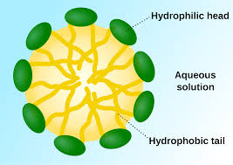
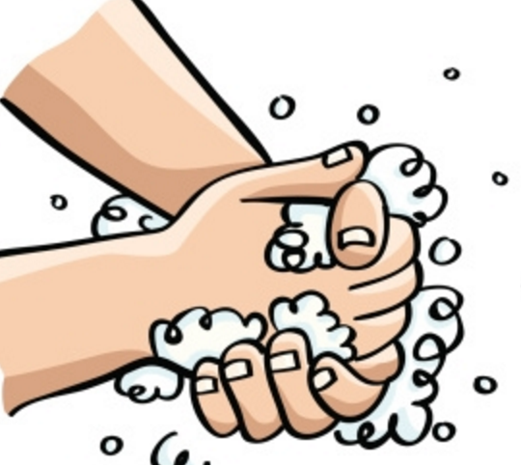
Experiment: Water and Oil
What happened?
The oil does not like water (hydrophobic) so it wants to get away from it.
Why is oil hydrophobic?
Polarity! Water is polar and oil is nonpolar.
Remember “Like – Likes – Like”
What can bring the two together?
DETERGENT!
Detergent contains micelles that package the oil inside their hydrophobic core while their hydrophilic outside is contacting the water.
This is how washing your hands with soap works!
en.wikipedia.org
Notes:
http://www.sciencekids.co.nz/experiments/oilandwater.html
In a clear container, mix a half-cup of water with a tablespoon of oil. Explain why the oil and water do not mix. Find a substance that will help the two combine, and add it to the mixture. Describe what happened, and explain how that substance worked to combine the oil and water.
REVIEW POLARITY AND HYDROPHOBIC/PHILIC

Slide 28
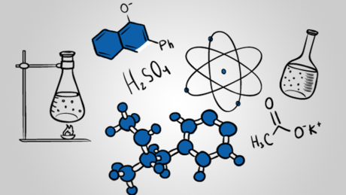
The 4 Classical Divisions of Chemistry
Analytical Chemistry
Inorganic Chemistry
Organic Chemistry
Physical Chemistry
https://www.coursera.org/course/chemistry1
Notes:
Briefly describe each one, and tell how it applies to your everyday life

Slide 29
1. Analytical Chemistry
Analytical Chemistry focuses on these two questions…
What is in the sample?
How much of some specific material is in the sample?
REAL WORLD APPLICATIONS!
A great example of Analytical Chemistry being used in the real world is Pharmaceutical Products.
The product (medications) that is being made by a pharmaceutical company has to be very accurate. Why?
You will find Analytical Chemistry labs at pharmaceutical companies where they run Qualitative and Quantitative tests on the product before it goes out for the public use.
The ‘What?’ is called Qualitative Analysis.
The ‘How much?’ is called Quantitative Analysis.
Concentration is the measurement we use to describe how much of a specific material is in the sample.
Notes:
Why do pharmaceutical products have to be exact?

Slide 30
2. Inorganic Chemistry
Inorganic Chemistry is the study of all elements and their compounds except carbon-containing compounds.
Metals are among the most useful inorganic materials.
Can you name some metals?
Metals are shiny, hard, and able to conduct heat and electricity.
Some metals are elements, but many are ALLOYS.
Alloys are made of two or more elements.
Crystals are a great example of an alloy!
REAL WORLD APPLICATIONS!
Everyday objects that are made of metals/alloys:
Jewelry (sterling silver, 18K gold)
Paper Clips
Keys
Coins
Notes:
Metals:
Aluminum
Iron
Copper

Slide 31
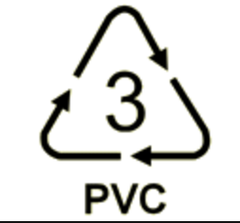
3. Organic Chemistry
Organic Chemistry is the study of the carbon compounds (all life depends on these… and water!)
Carbon is found in:
Gases and oils
Living cells – DNA contains a carbon ring.
Plastics
REAL WORLD APPLICATIONS!
Plastics are organic material that we use everyday! They are POLYMERS made of long chains of MONOMERS.
There are many kinds of plastics:
Nylon
Polystyrene
PVC
Polyethylene
Notes:
REAL WORLD APPLICATION:
1. Define Polymers and monomers
Polymers = long chains of molecules – formed by chemically linking many smaller molecule units (MONOMER) together.
2. Describe the symbol for polymers – the number refers to the type of plastic – ex: 3 is designated for PVC.. Encourage scouts to take notice of these symbols on any plastics like bottles, tupperware etc.

Slide 32
3. Physical Chemistry
REAL WORLD APPLICATIONS!
This branch of Chemistry is where physics and chemistry work together!
Physical Chemistry describes and measures chemical events and the characteristics of atoms and molecules.
Some characteristics Physical Chemistry can describe:
Distance between two atoms in a molecule
Spatial arrangement (relationship to one another in space)
The strength of the bond between atoms that holds the molecule together.
Backpacking/Hiking
When you are backpacking in the mountains it gets more difficult to breathe as you ascend to the top. Why is that?
At sea level, the atmosphere (air) is about 21% oxygen.
As you increase in altitude, the % of oxygen in the air becomes less and less.
Scuba Diving
As a scuba diver descends to the ocean floor, the water pressure increases.
The weight of the water pushes the diver down… increasing pressure.
High pressure squeezes the diver’s chest.
Diver must breath high-pressure air to fill their lungs
Notes:
Pg. 69

Slide 33
Section 4: Application

Slide 34
Government Agencies
2 Examples:
American Society for Testing and Materials (ASTM)
Environment Protection Agency (EPA) - protects human health, air, water, and land. EPA is responsible for enforcing the environmental law set by congress.
http://allenwestrepublic.com/2014/07/09/epa-now-claims-it-can-garnish-wages-without-court-approval/
Notes:
Name 2 govt agencies responsible for tracking the use of chemicals for commercial and industrial use
Pick one of the agencies and briefly describe its responsibilities to the public and environment.

Slide 35
Pollution
Pollution is the introduction of harmful substances or products into the environment.
Ozone: 3 oxygen molecules make an ozone molecule (O₃)- Makes up a thin layer of atmosphere about 20 miles above Earth. It acts like a sunscreen for the earth. When it the ozone is damaged then we are at risk of increased UV radiation exposure.
Global Warming: CO2 is not normally pollutant. But it is a greenhouse gas and contributes to the Greenhouse Effect.
Acid Rain: the burning of fossil fuels releases oxides of sulfer and nitrogen. These can react with water within the atmosphere. This forms corrosive acids that can damage the environment, like damaging trees. These acids fall with the rain.
Notes:
DISCUSSION OVER GLOBAL WARMING
What is a greenhouse gas? Something that traps heat more than oxygen (ex: Methane, NO)
Greenhouse effect: some of the heat energy is trapped within our atmosphere so that Earth says warm. The greenhouse gases help with this because they are really good at trapping heat. So the significant changes in the Earth’s temperature could have dramatic consequences. We can try to reduce the amount of CO2 we add to the environment or replace the lost vegetation like the rain forests.

Slide 36
Effects on the Environment
Sulfur from burning coal:
Burning coal can produce many pollutant gases.
One example is sulfur dioxide (SO₂)
Coal-fired power plants is a huge contributor to global warming.
http://www.alexmaclean.com/books/look-at-the-land/Land_LS_2610_27
Notes:
Pg. 84-89
Using reasons from chemistry, describe the effect on the environment of ONE of the following: sulfur from burning coal

Slide 37
Fertilizer and Laundry Detergents
The phosphates in fertilizer is used by the plants for:
nucleic acids (DNA!),
proteins,
energy (in the form of ATP)
Cellulose (a building block to maintain structure for plants)
Phosphates are also used in in laundry detergent for:
Preventing “hardness of water”
So it is a water softener
Low cost
Low toxicity
Discussion: How does this affect the environment?
Discussion: Why has phosphates been removed from detergents?
Notes:
Plants need mineral nutrients (not just water and CO₂) to survive and grow.
So farmers use fertilizers to prevent crop loss.
DETERGENTS: HARD WATER contains inorganic salts (like Calcium carbonate or Magnesium salt) → causes SOAP SCUM
Phosphorous binds firmly to those ions in the hard water so that surfactant micelles can attach to dirt and oils.
DISCUSSION: when rainwater runs off fertilized grass or an agricultural field, the Phosphate in fertilizers can get carried along with it. Can lead to the same issue seen with use of phosphates in laundry detergent. Discuss this next.
DISCUSSION: they seemed perfect for laundry detergents as a water softener until algae in some lakes grew out of control and covered the top of the water. Fish couldn’t get oxygen from the air above (it dissolves in the water for them to breathe) because of this. So fish suffocated. So what does this have to do with Phosphorous? Well chemists found tha phosphates are excellent nutrients for algae (JUST LIKE THE FARMER’S CROPS… they are plants). And laundry detergent from posphates from washing machine drainage would be dumped into rivers and lakes. So now phosphate has been removed from laundry detergents.

Slide 38
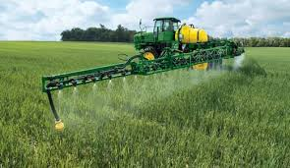
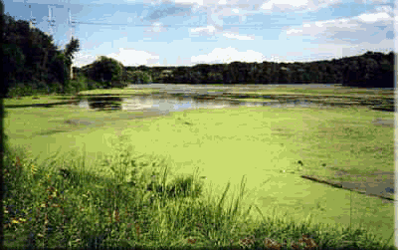
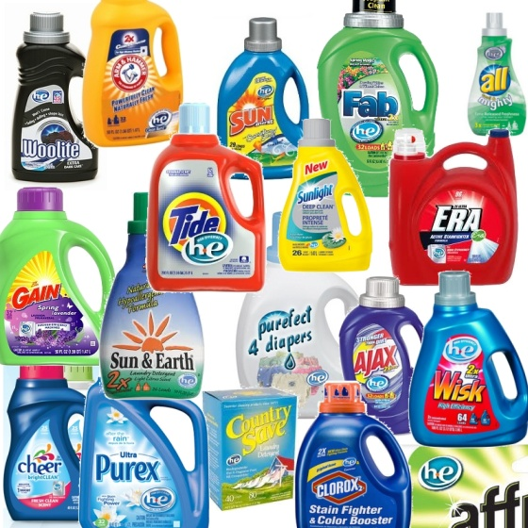
http://www.kings-gate-west.com/2011/05/use-he-liquid-laundry-detergent-in-new.html
http://www.macalester.edu/academics/environmentalstudies/threerivers/studentprojects/ENVI_133_Spr_08/Phosphorus/Phosphorus%20Effects%20Webpage.html
http://www.kings-gate-west.com/2011/05/use-he-liquid-laundry-detergent-in-new.html

Slide 39
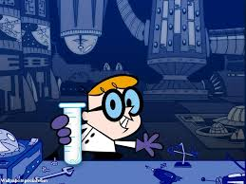
TO THE LABORATORY!
Notes:
http://blacknerdproblems.com/staff-beef-dexters-lab-the-crown-jem-of-cartoon-networks-renaissance-era/

Slide 40
THANK YOU!

